Slide 1
Transformer
Language Models

Slide 2
Course Contents
Deep Learning
Transformer
Finetuning
Prompting & Agents
The Bigger Picture

Slide 3
Transformer
tokenizer
static embeddings
contextual embeddings
text generation

Slide 4
Modern Language Models in a Nutshell
text preprocessing:
tokenization: split text into chunks (typically sub-words)
self-supervised pretraining of transformer (next- or masked-token prediction):
vector embeddings (learned via bag-of-words or end-to-end in transformer): semantic meaning of tokens → not yet context-aware
add positional encoding to embeddings: use order of sequence (attention is permutation-invariant)
self-attention → contextual embeddings
supervised finetuning (for specialization):
finetuning for specific task (encoder LLM)
instruction tuning followed by alignment (decoder LLM)

Slide 5
Tokenization
tokenization: breaking text in chunks
word tokens: different forms, spellings, etc → undefined and vast vocabulary
character tokens: not enough semantic content (longer sequences)
popular compromise: byte-pair encoding

Slide 6
Byte-Pair Encoding
data compression method used for encoding text as sequence of tokens (sub-words)
merging token pairs (starting with characters) with maximum frequency
continue merging until defined fixed vocabulary size (hyperparameter) is reached
common words encoded as single token
rare words encoded as sequence of tokens (representing word parts)
alternative: direct operation on bytes (e.g., ByT5)
aaabdaaabac
ZabdZabac
Z=aa
ZYdZYac
Y=ab
Z=aa
XdXac
X=ZY
Y=ab
Z=aa
example from wikipedia

Slide 7
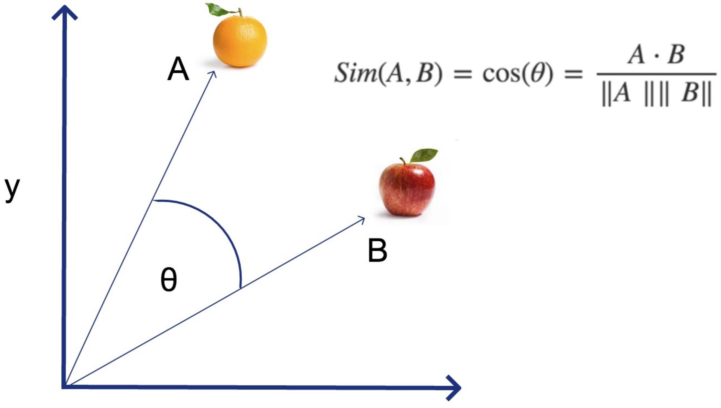
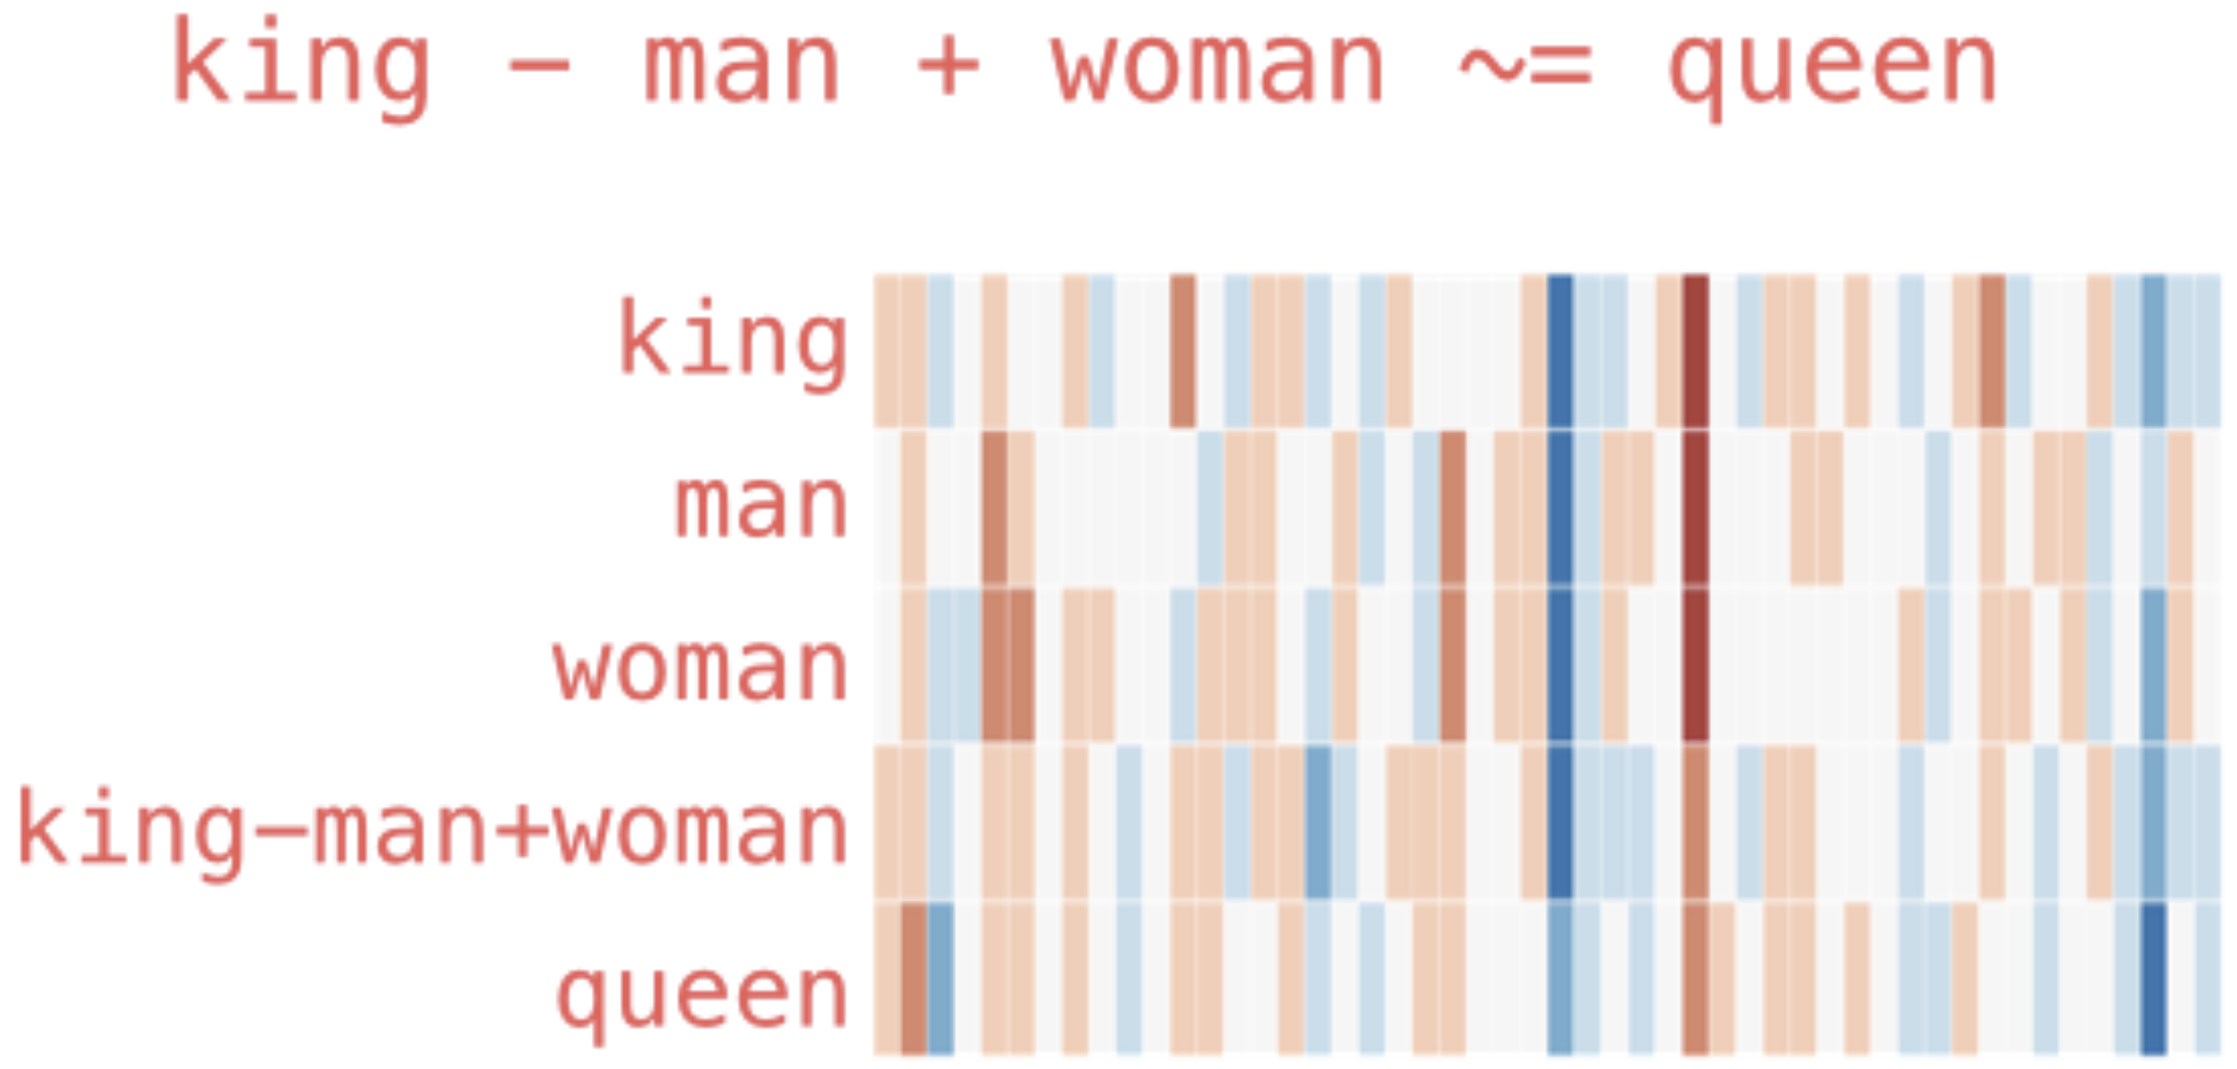
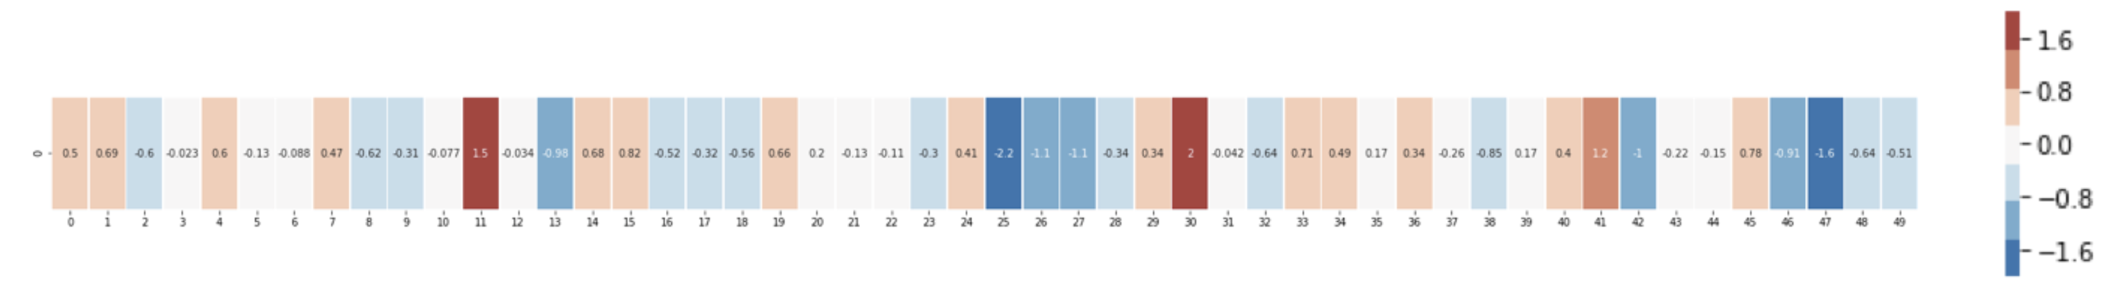
Embedding Layers
representation of entities by vectors
→ semantic similarity
most famous application: word embeddings
→ associations (natural language processing)
but general concept: embeddings of (categorical) features (e.g., products in recommendation engines)
learned via co-occurrence (e.g., word2vec)
but also direction of difference vectors interesting (analogies):
source

Slide 8
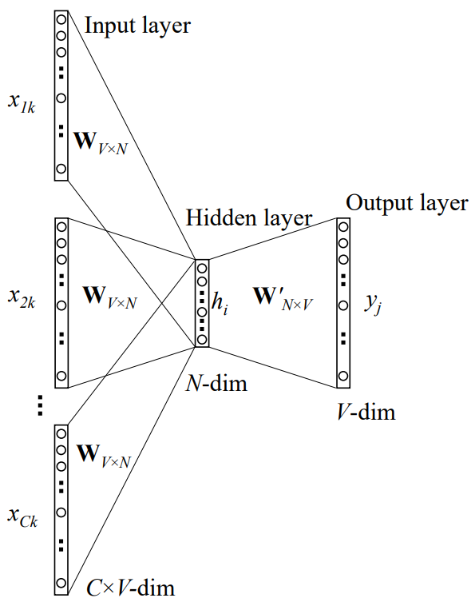
Some Thoughts on Word Embeddings
can be implemented as
neural network with single hidden layer (linear activation)
using, e.g., bag-of-words approach (predict masked word from its surroundings)
not context-aware
CBOW:
source
softmax of target word
word vector (embedding) by multiplication with one-hot vector
one-hot vectors of context words

Slide 9
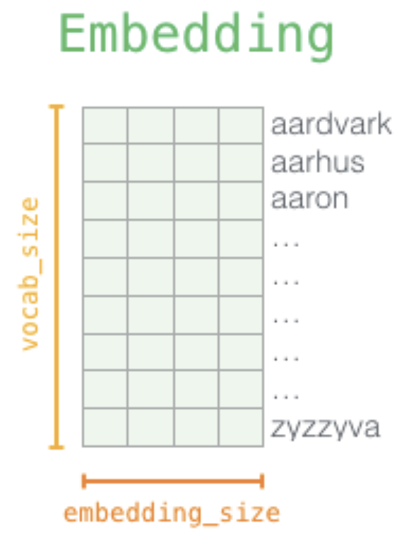
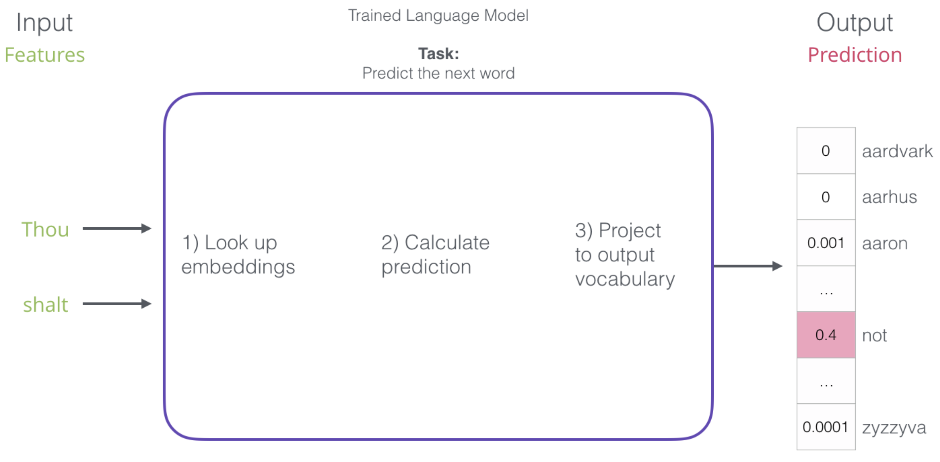
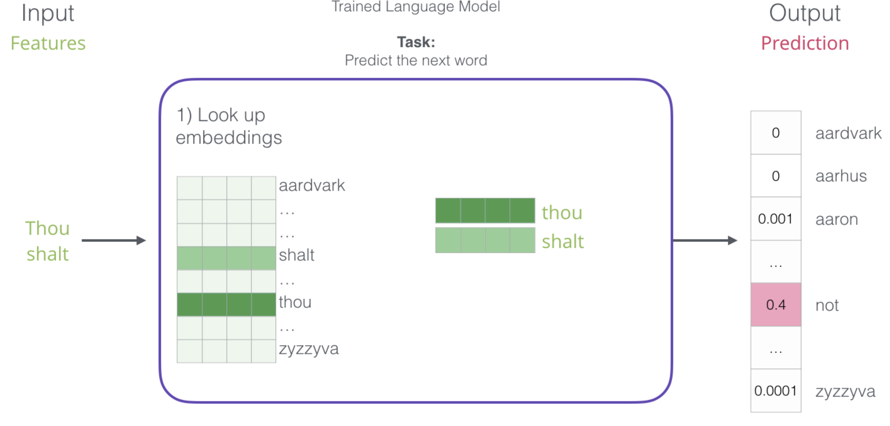
Word Embeddings as Part of Language Model
language models contain embedding matrix as part of learned parameters
typically several hundred dimensions for word vectors (to be compared with vocabulary sizes of many thousands)
(can also be extracted and subsequently used as pretrained embeddings for other task)
next-word prediction:
source

Slide 10
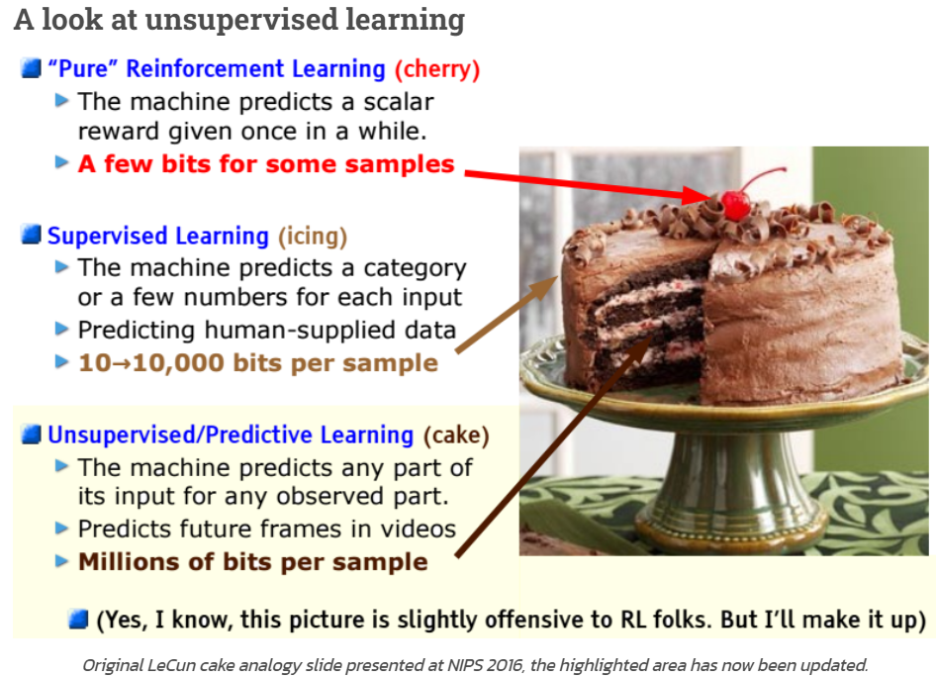
Self-Supervised Learning
ML needs lots of training data
unsupervised learning (learning by observation)
no target information → kind of “vague” pattern recognition (but plenty of data)
can be cast as self-supervised learning:
input-output mapping like supervised learning
but generating labels itself from inputs
source
The Lord of the Rings is considered one of the greatest fantasy
The Lord of the Rings is considered one of the greatest fantasy books

Slide 11

Context Awareness: Transformer
original transformer: sequence-to-sequence model (e.g., for machine translation)
Attention Is All You Need:
completely replaced recurrent neural networks (RNN)
much more parallelization → bigger models
better long-range dependencies thanks to shorter path lengths in network (less sequential operations)
encoder/decoder stacks (depth): output fed as input to next one
encoder
decoder

Slide 12
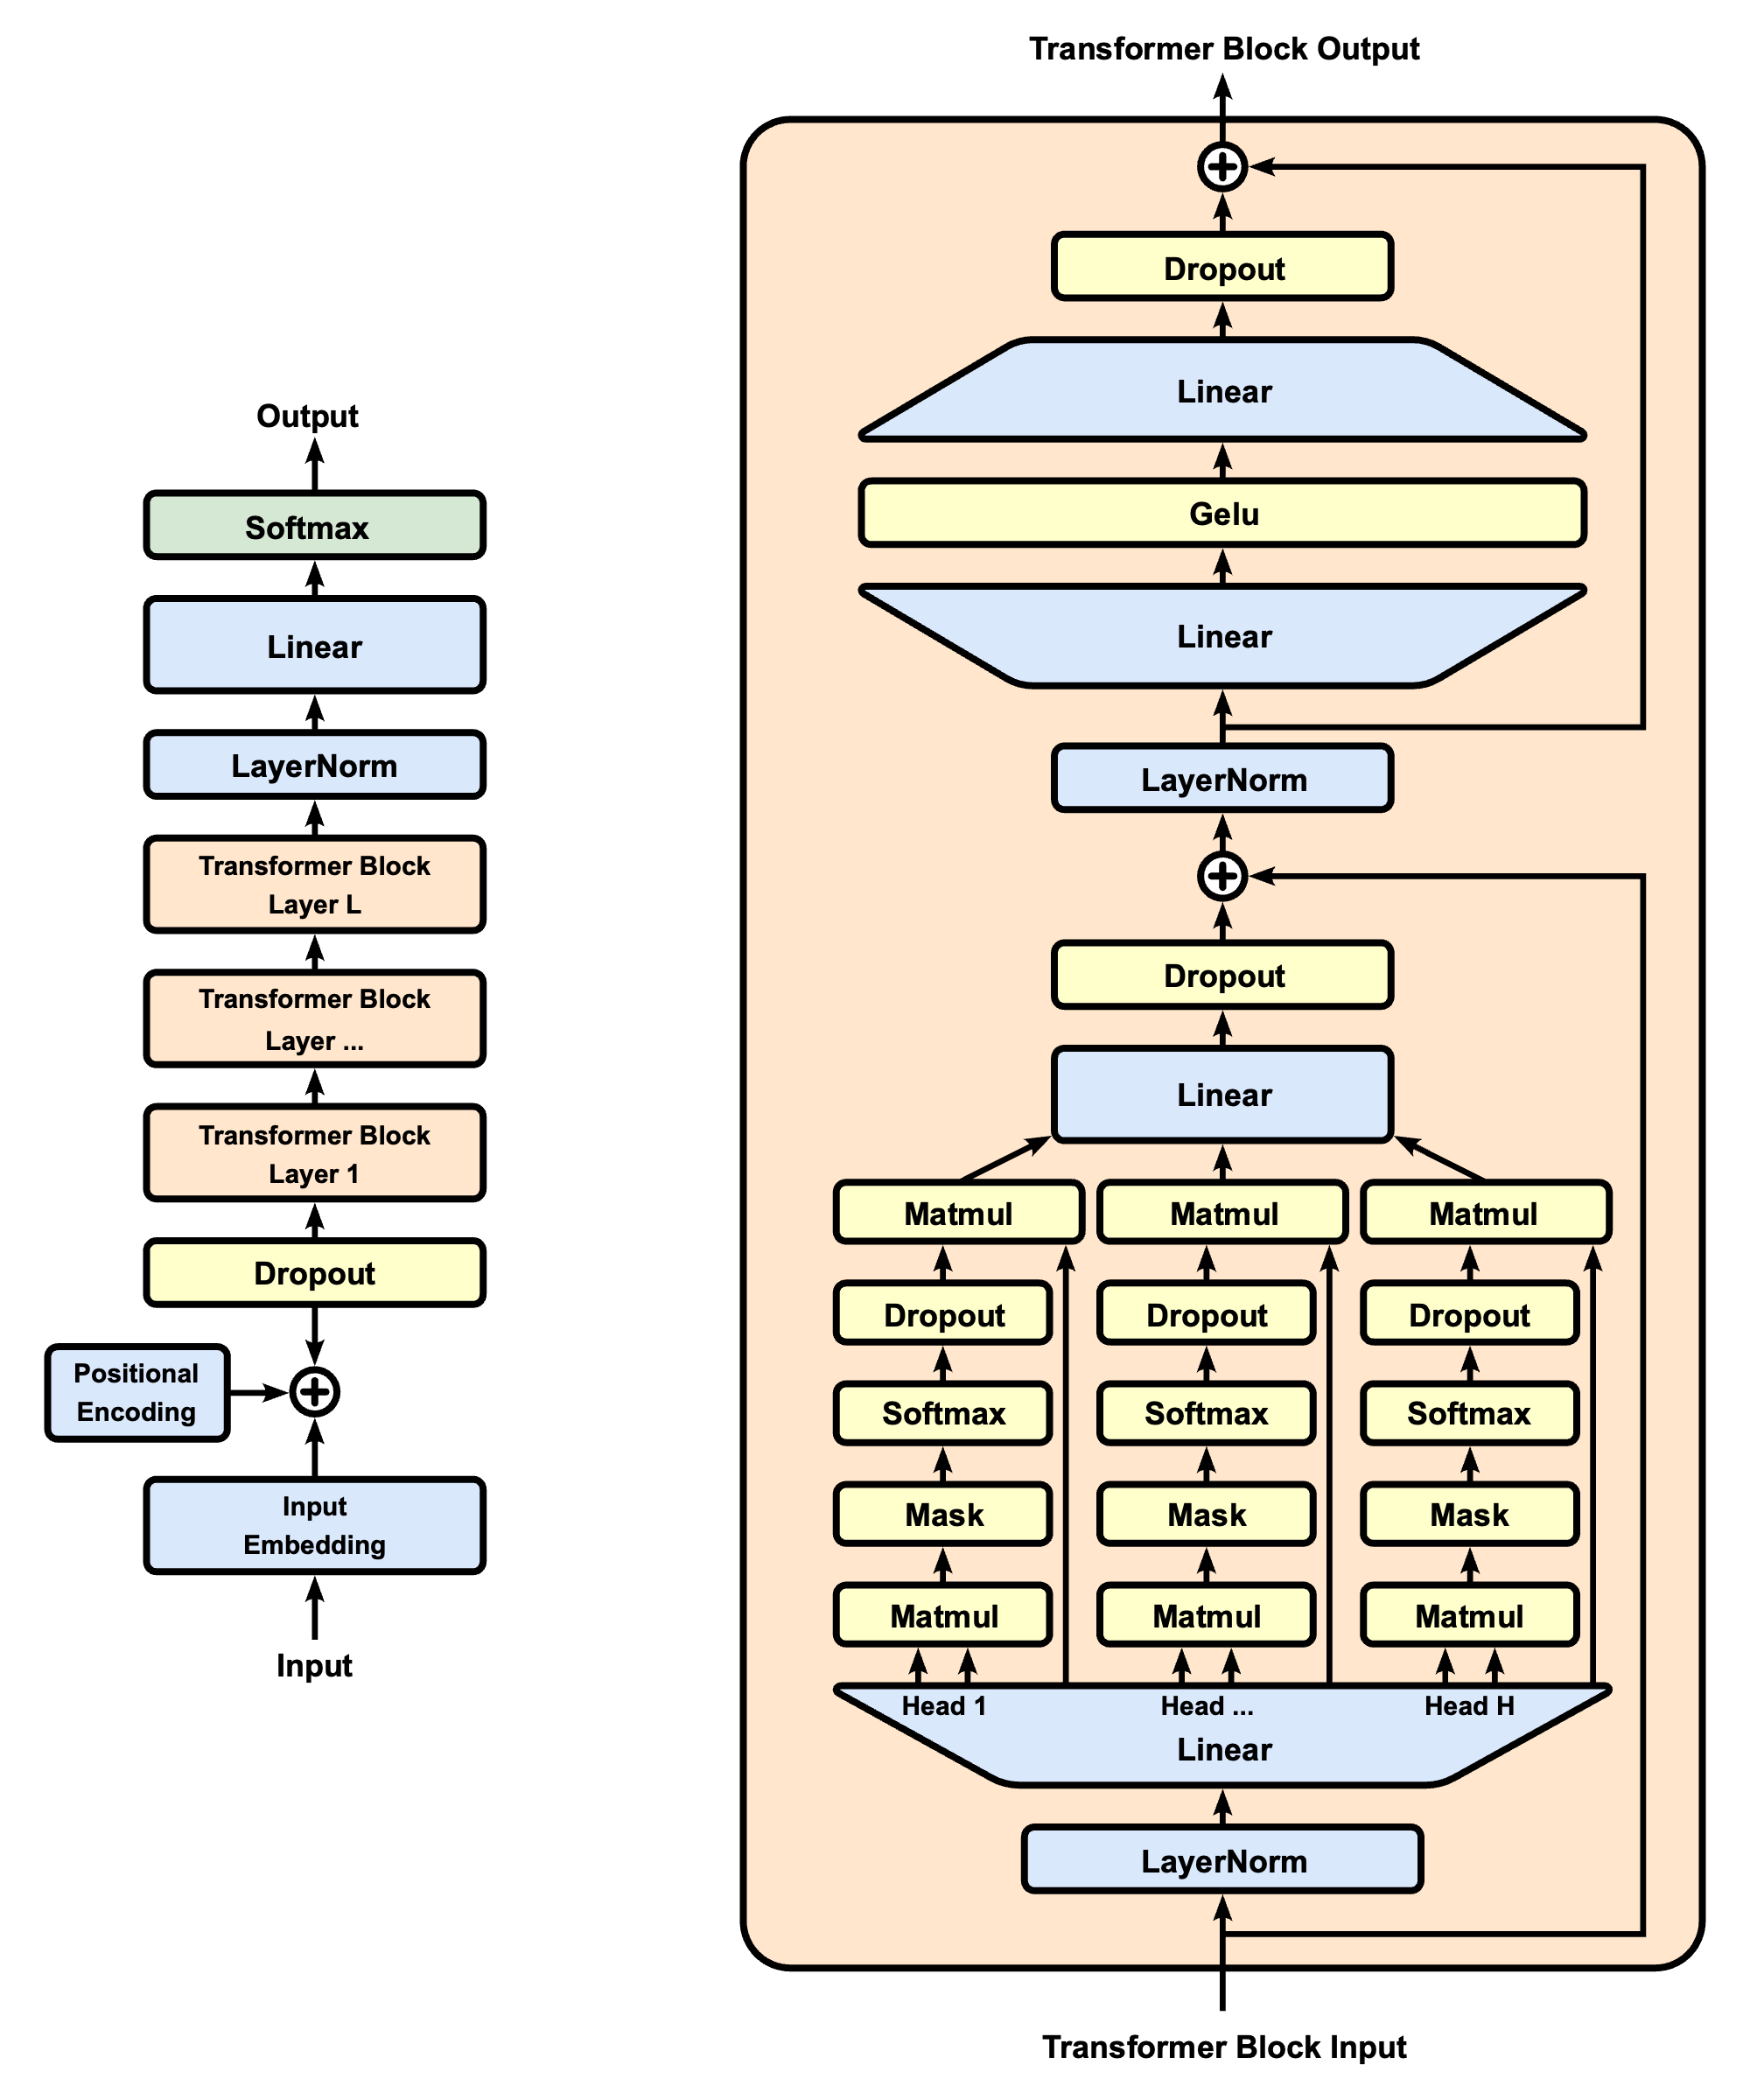
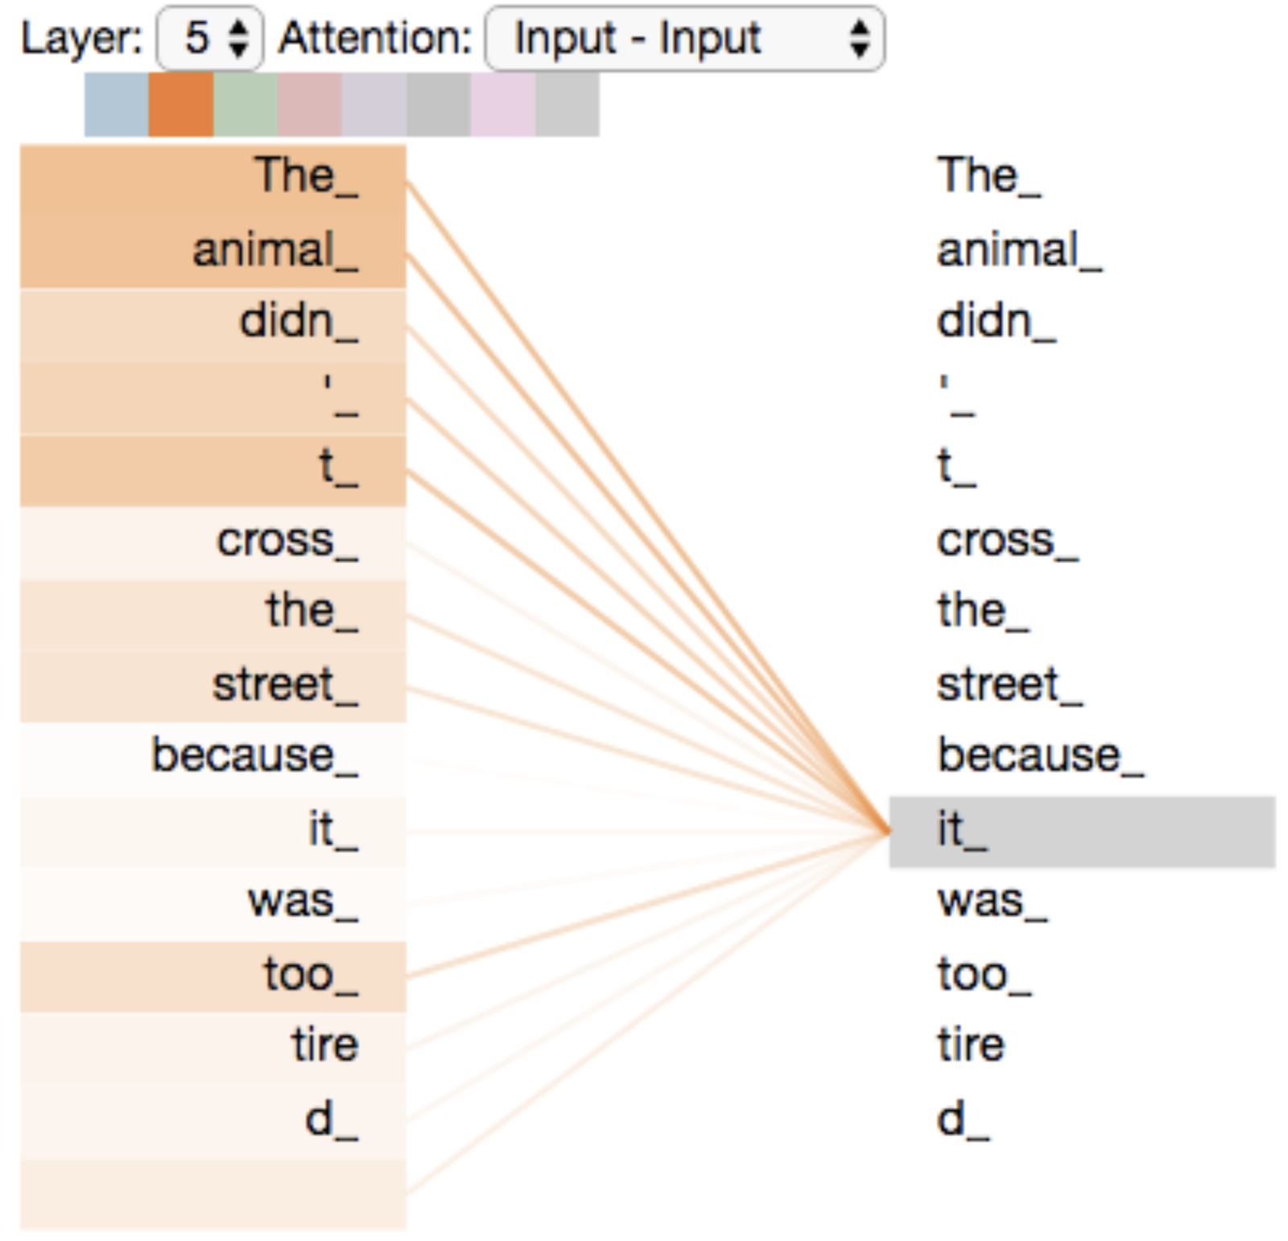
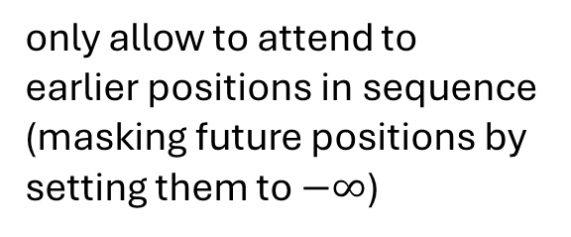
Self-Attention Mechanism
GPT (decoder-only):
evaluating other input tokens in terms of relevance for encoding of given token
computational complexity quadratic in length of input (each token attends to each other token)
only allow to attend to earlier positions in sequence (masking future positions by setting them to $−∞$)
source

Slide 13
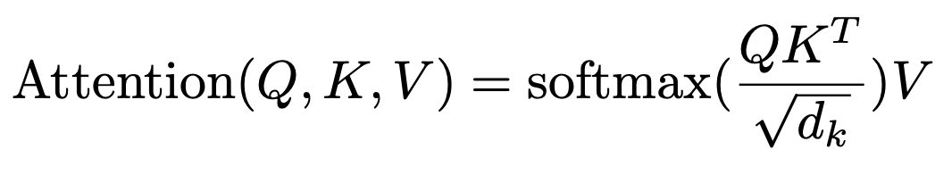

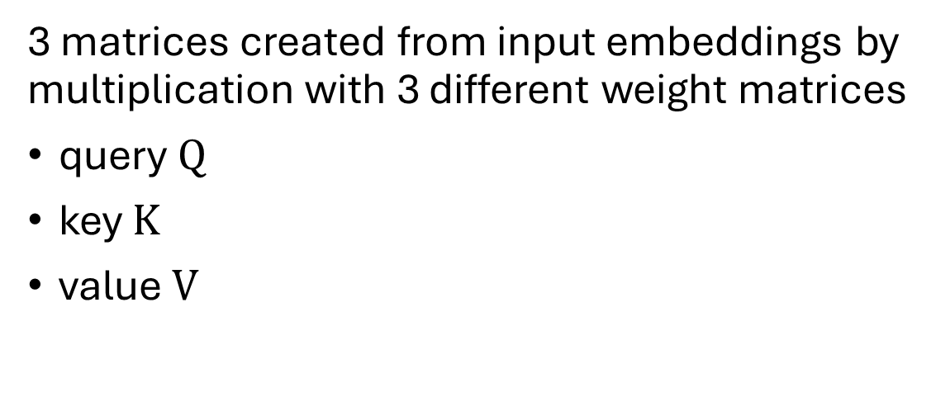
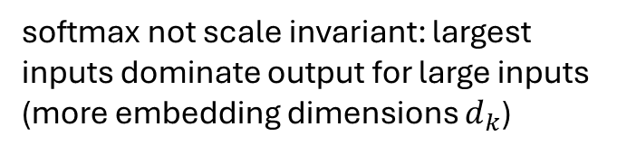
Scaled Dot-Product Attention
softmax not scale invariant: largest inputs dominate output for large inputs (more embedding dimensions $d_{k}$)
3 matrices created from input embeddings by multiplication with 3 different weight matrices
query $Q$
key $K$
value $V$
filtering: multiplication of attention probabilities with corresponding key-word values
scoring each of the key words (context) with respect to current query word: multiplication of inputs (in contrast to inputs times weights in neural networks)
key-value pairs
query
source

Slide 14
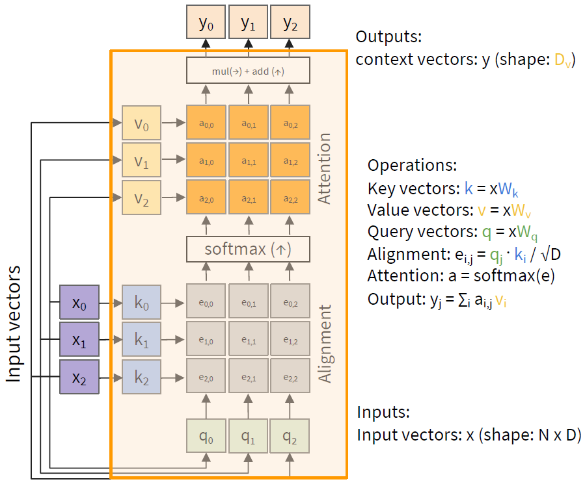
MatMul
weighted average: reflecting to what degree a token is paying attention to the other tokens in the sequence

Slide 15
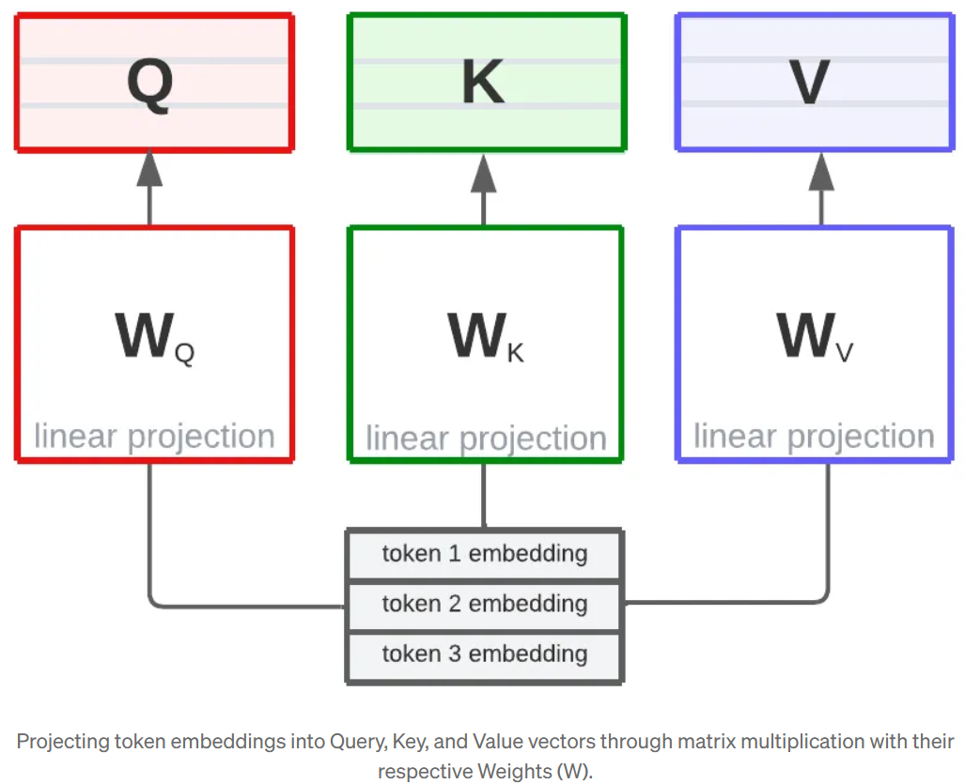
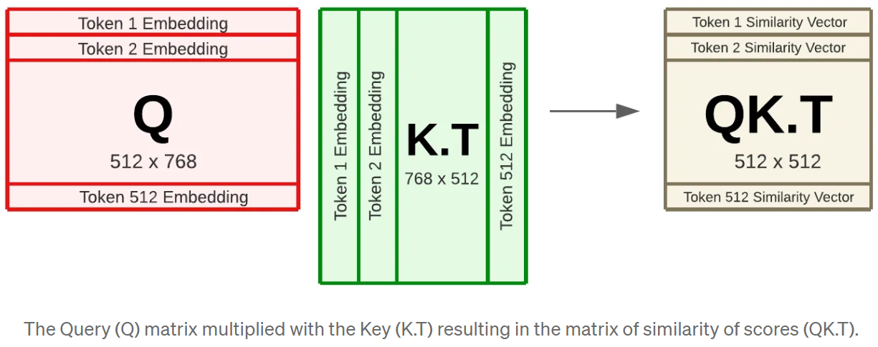
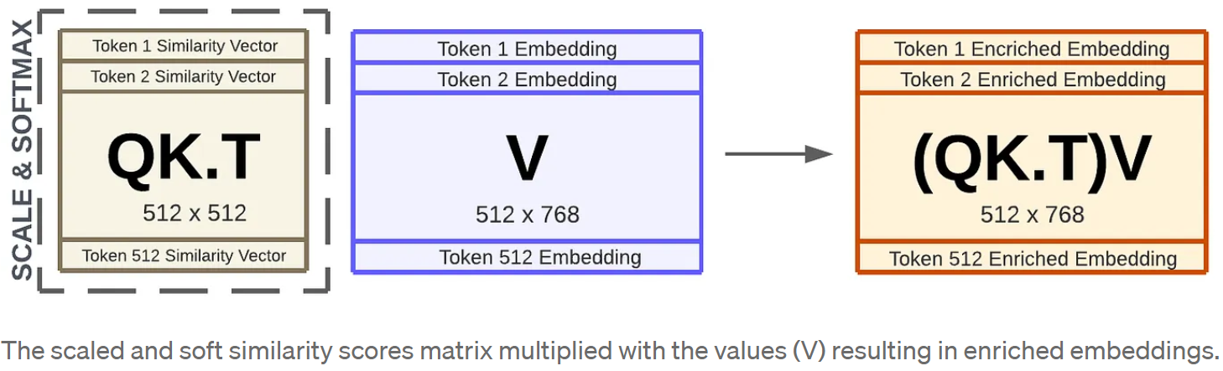
Example: Dimensions in BERT
2
1
3
source

Slide 16
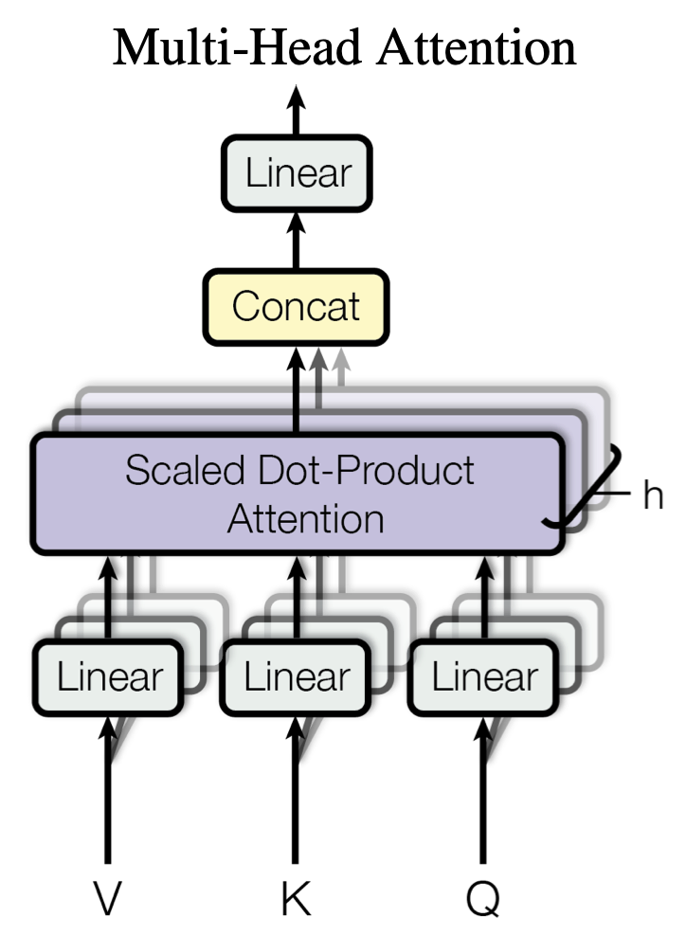

Multi-Head Attention
multiple heads: several attention layers running in parallel
different heads can pay attention to different aspects of input (multiple representation sub-spaces)
source
source

Slide 17
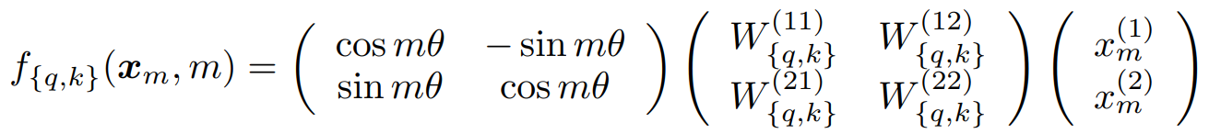
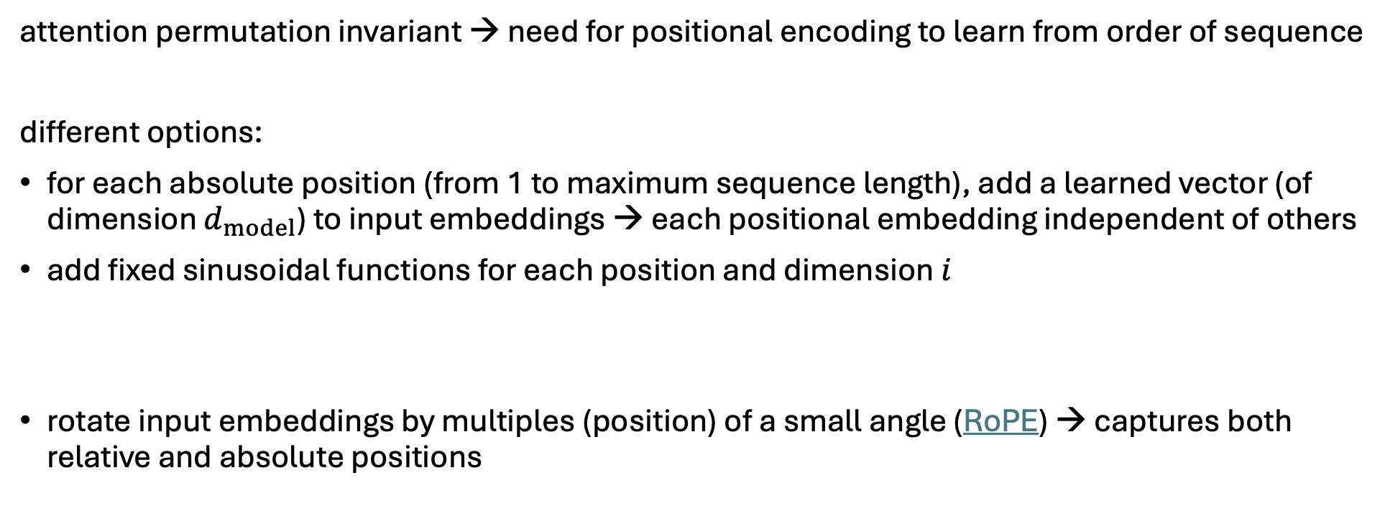
Positional Encoding
attention permutation invariant → need for positional encoding to learn from order of sequence
different options:
for each absolute position (from 1 to maximum sequence length), add a learned vector (of dimension $d_{model}$) to input embeddings → each positional embedding independent of others
add fixed sinusoidal functions for each position and dimension $i$
rotate input embeddings by multiples (position) of a small angle (RoPE) → captures both relative and absolute positions
$${PE}_{pos,2i}=\sin\left(\frac{pos}{{10000}^{\frac{2i}{d_{model}}}}\right) {PE}_{pos,2i+1}=\cos\left(\frac{pos}{{10000}^{\frac{2i}{d_{model}}}}\right)$$

Slide 18
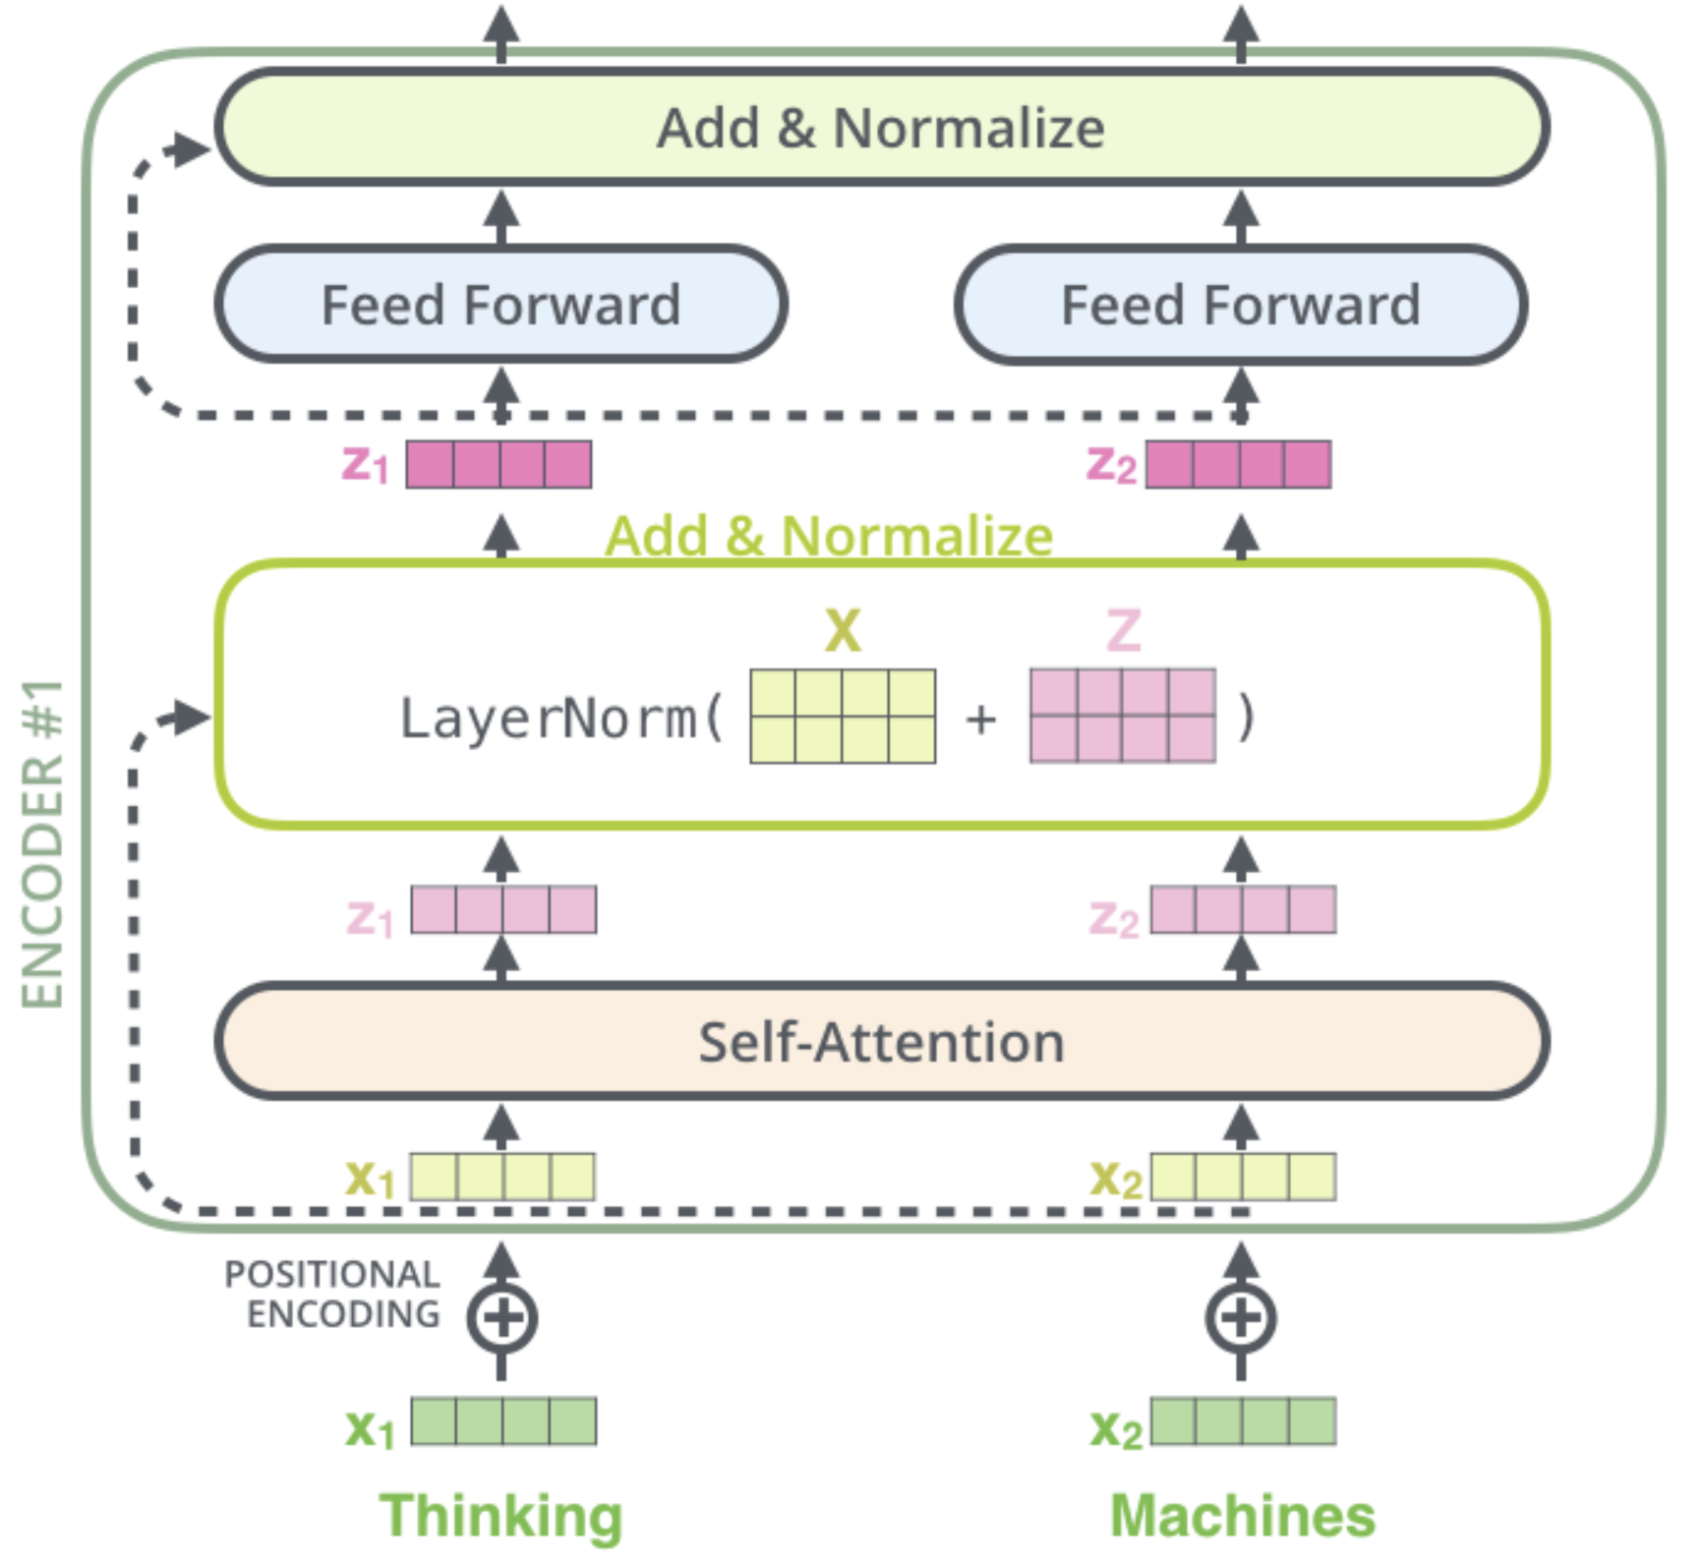
Skip Connections and Layer Normalization
skip connections improve robustness by
preserving original input (attention layers as filters) as well as gradients (mitigate vanishing-gradient problem)
easier learning of identity functions (useful for disregarding modules that do not improve model performance)
layer normalization improves stability, convergence, and generalization by normalizing activations per input token
source

Slide 19
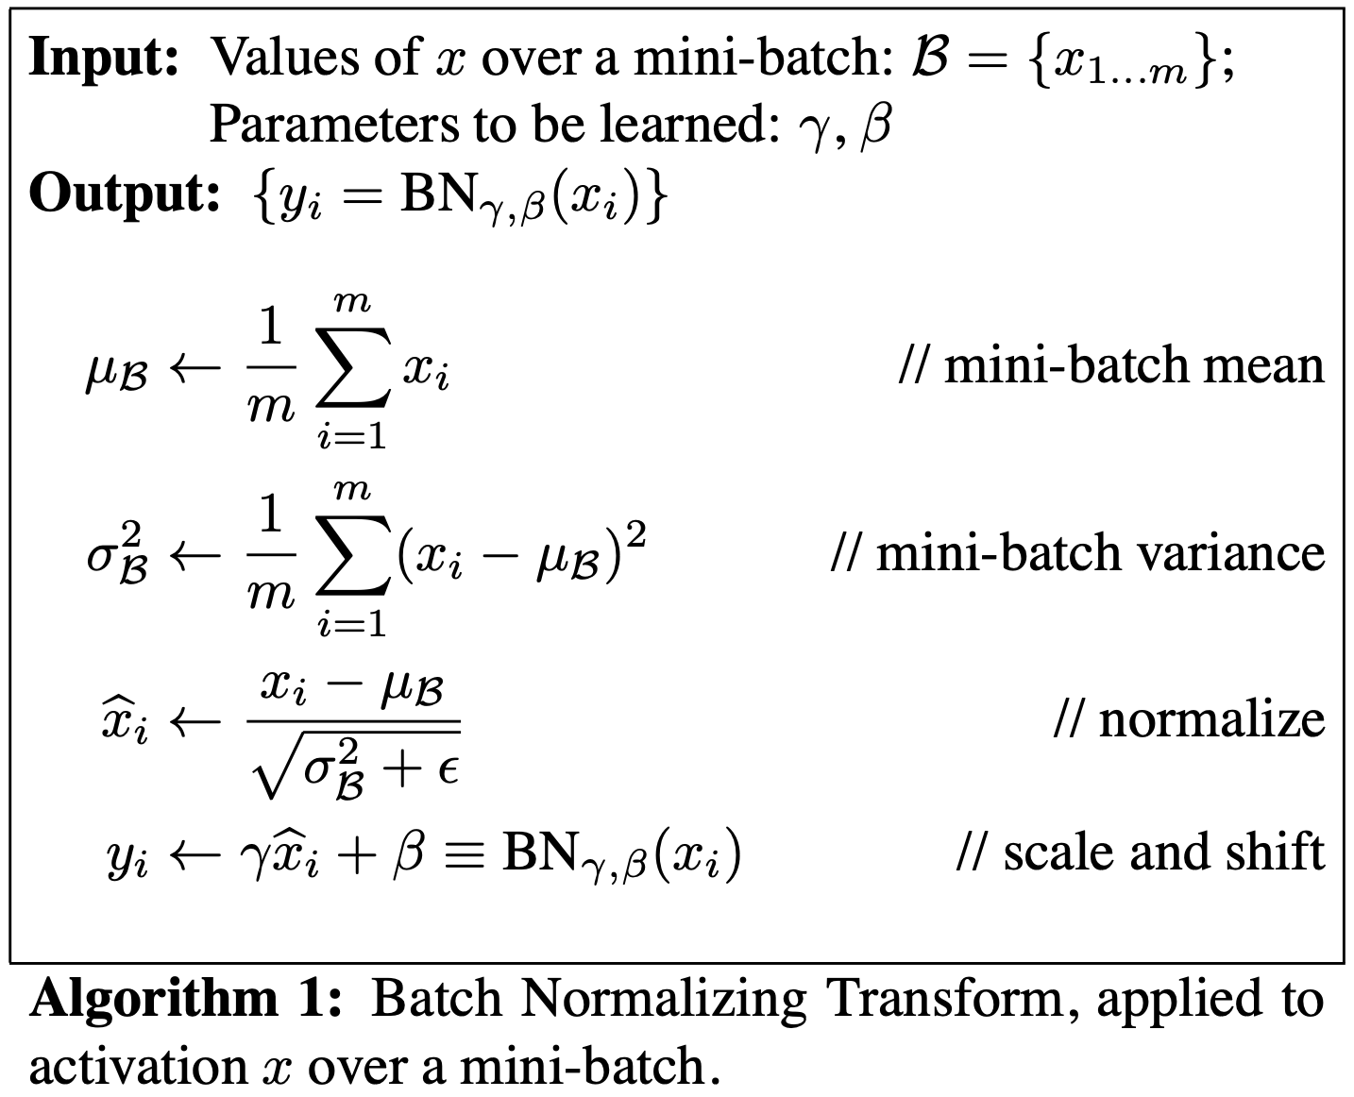
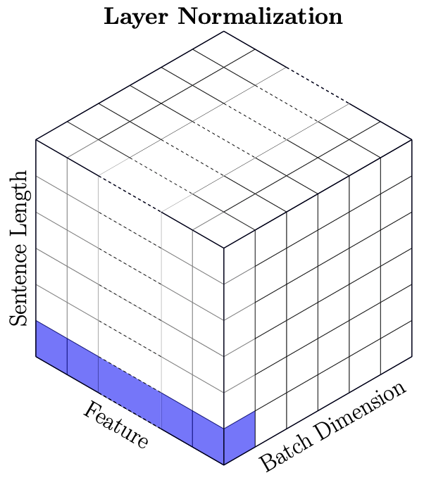
Batch vs Layer Norm
batch norm typically in computer vision
layer norm in NLP (variable-sized inputs)
source

Slide 20
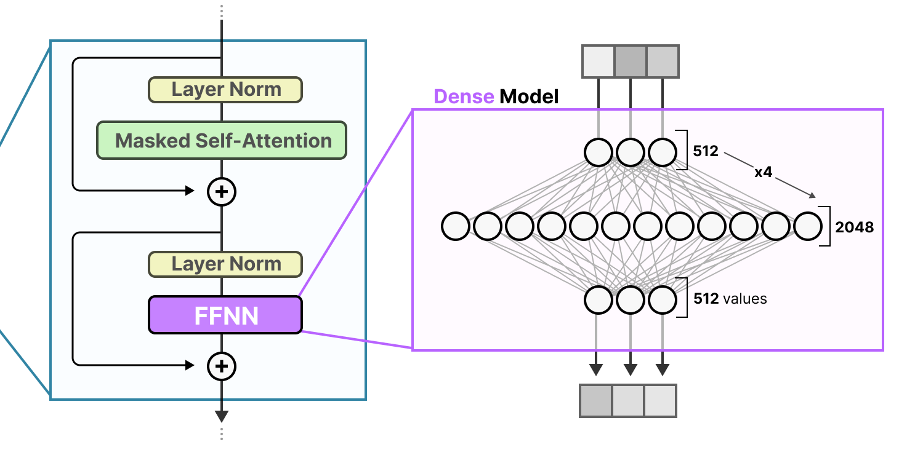
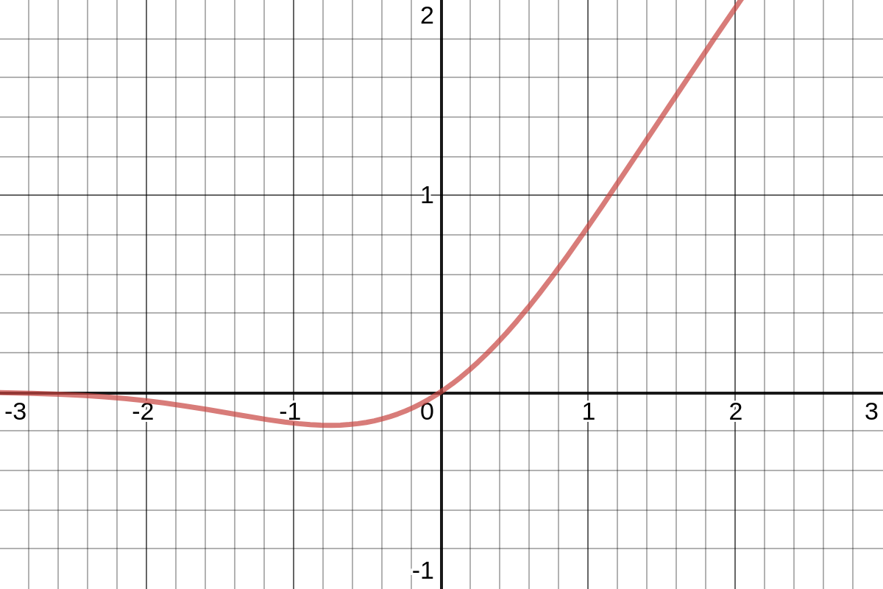
Role of Feed-Forward Neural Networks (FFNN)
position-wise FFNNs:
following each attention layer, apply an identical FFNN (with two layers) independently to each embedding vector
(correspond to bulk of overall parameters)
source
can be interpreted as compute after connect (attention)
attention is just weighted averaging
→ need for non-linearities (often GeLU activations) to capture more complex patterns

Slide 21
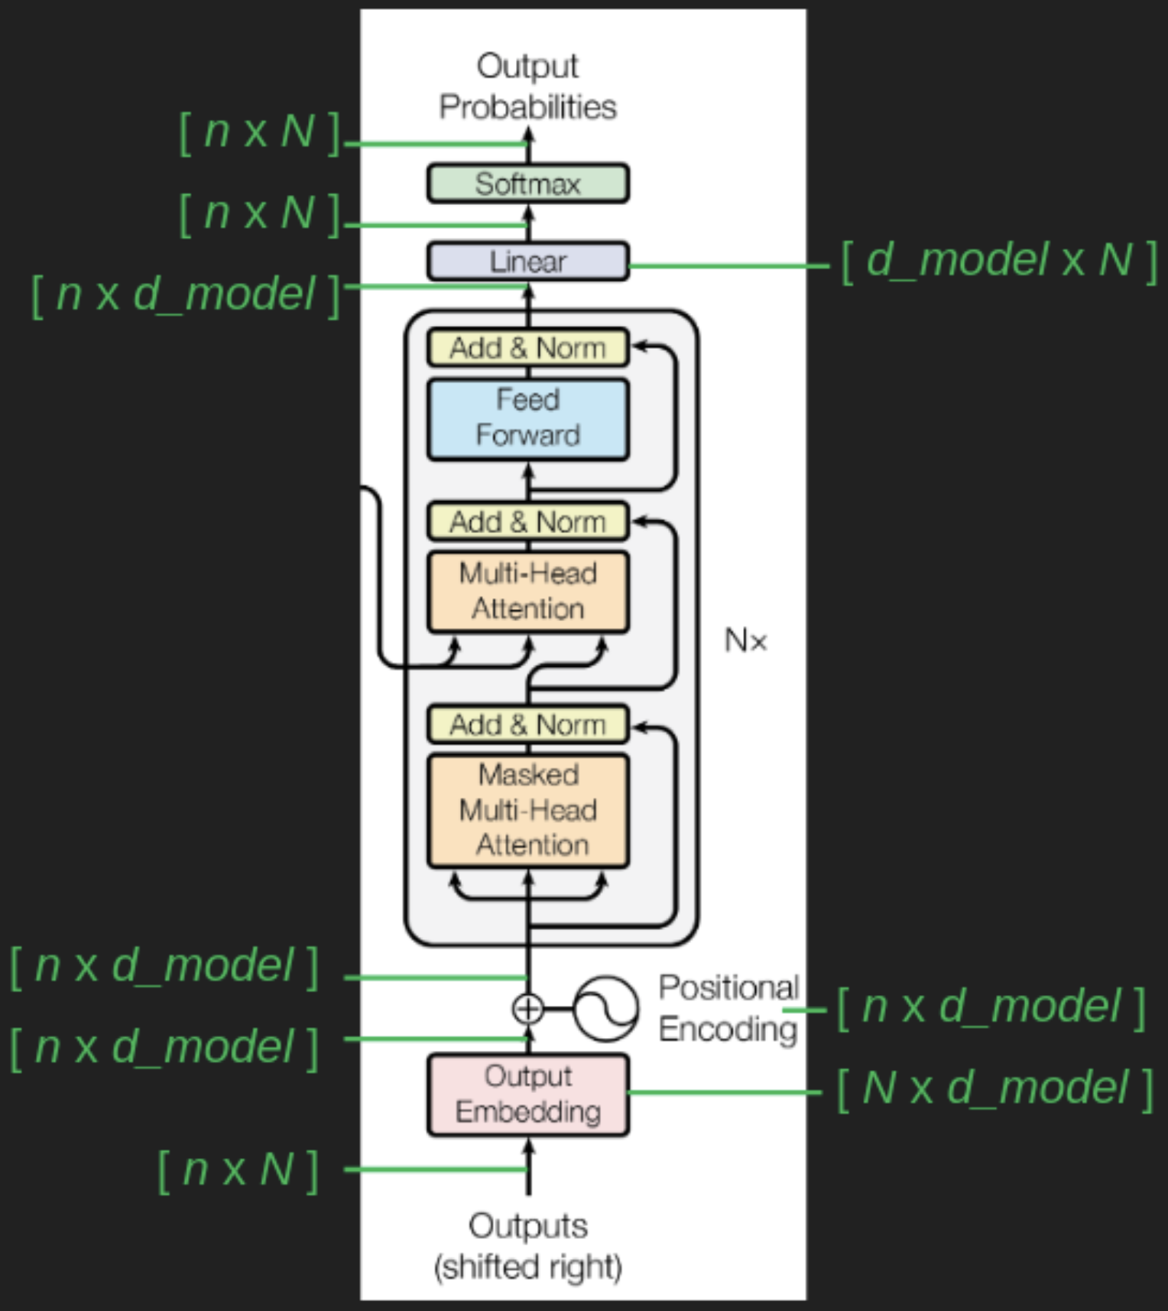
De-Embedding and Softmax
conversion of final decoder output to predicted next-token probabilities for output vocabulary
de-embedding: linear transformation (fully-connected network layer) to vocabulary size
softmax: transformation to probabilities (“softness” can be controlled by hyperparameter → temperature)
n: sequence length
N: vocabulary size
d_model: embedding dimensions
source

Slide 22
Sequence Completion
autoregressive: for each step (iteratively), choose one output token and then add it to decoder input sequence for next step
typically, pick according to softmax probabilities (degree of randomness controlled by softmax temperature)
prompt: externally given initial sequence for running start and context on which to build rest of sequence

Slide 23
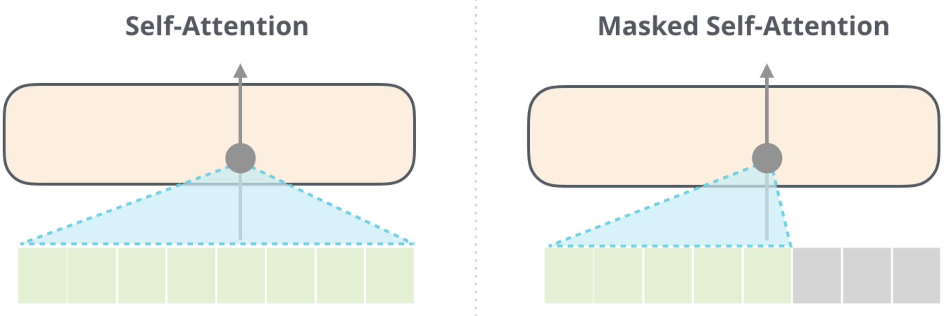
Transformer Architectures for LLMs
encoder-decoder LLMs: sequence-to-sequence, e.g., machine translation
encoder-only LLMs:
learning of contextual embeddings (for subsequent fine-tuning)
training: prediction of masked words
can’t generate text, can’t be prompted
decoder-only LLMs:
text generation: e.g., chat bot (after instruction tuning)
training: next-word prediction
output one token at a time (auto-regressive: consuming its own output, potentially starting with prompts)
aka causal
example: BERT
example: GPT
source

Slide 24
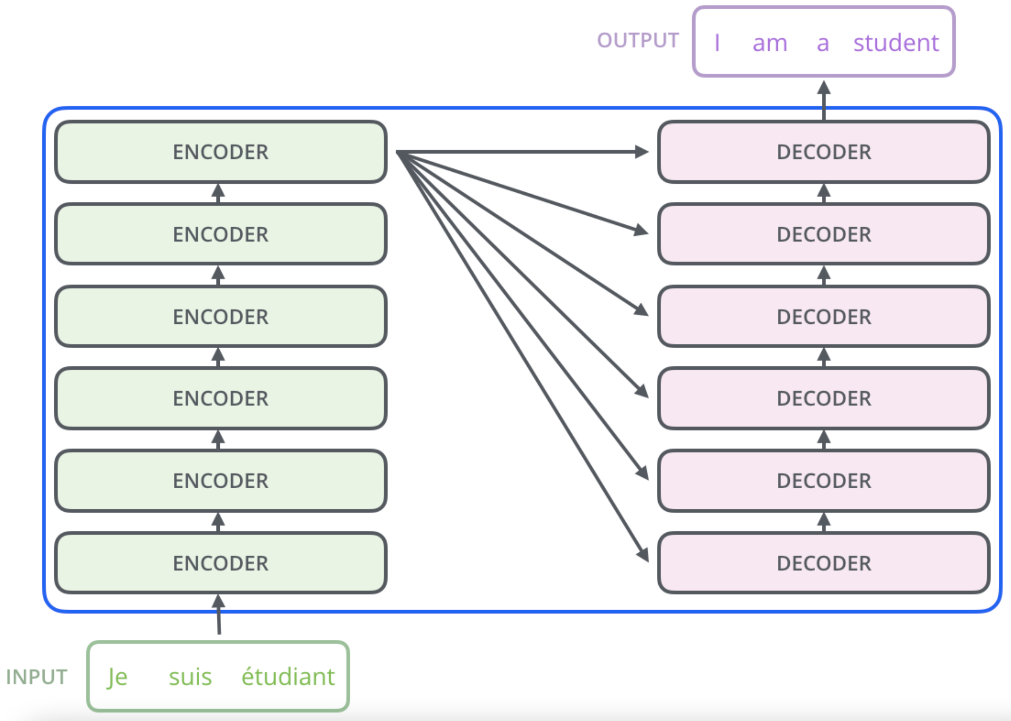
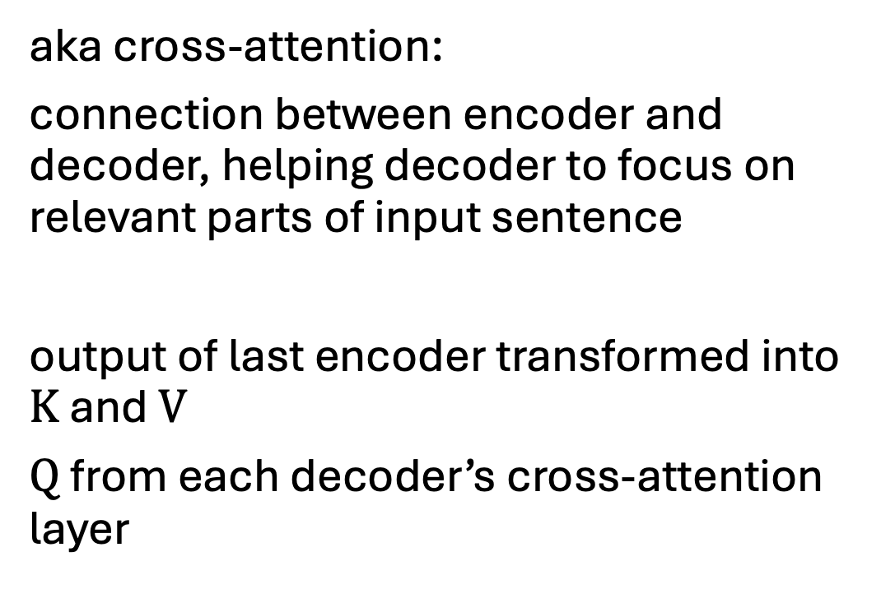
Encoder-Decoder Attention
aka cross-attention:
connection between encoder and decoder, helping decoder to focus on relevant parts of input sentence
output of last encoder transformed into $K$ and $V$
$Q$ from each decoder’s cross-attention layer
source

Slide 25
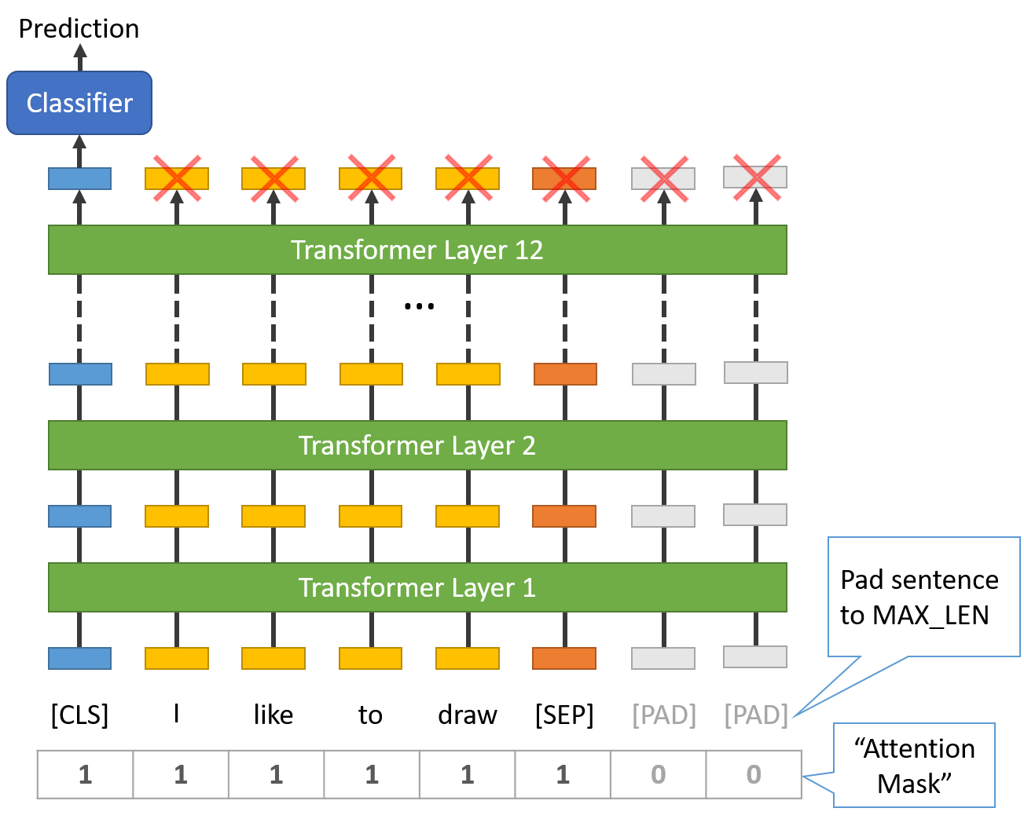
Example for Encoder-Only LLM
BERT (Bidirectional Encoder Representations from Transformers, Google):
stack of transformer encoders
outputting representation (contextual embeddings) to be used/finetuned in specific tasks and data sets (e.g., text classification)
bidirectional: jointly conditioning on both left and right context
pre-trained in self-supervised manner on massive data sets
masked tokens to be predicted from context
next sentence prediction
source
sentence classification via [CLS] token

Slide 26
Example for Decoder-Only LLM
GPT (Generative Pre-trained Transformer, by OpenAI) series:
stack of transformer decoders → auto-regressive language model
generative pre-training: self-supervised generation of text (i.e., next-word predictions) on massive web scrape data sets
GPT: discriminative fine-tuning on specific tasks (e.g., summarization, translation, question-answering) with much smaller data sets
GPT-2, GPT-3 (175 billion parameters): also zero- or few-shot learning
GPT-4: extend to multimodal model (image and text inputs, text outputs)
capabilities

Slide 27
Open-Source Implementations
lightweight PyTorch re-implementation of GPT: minGPT
more powerful: nanoGPT, LitGPT

Slide 28
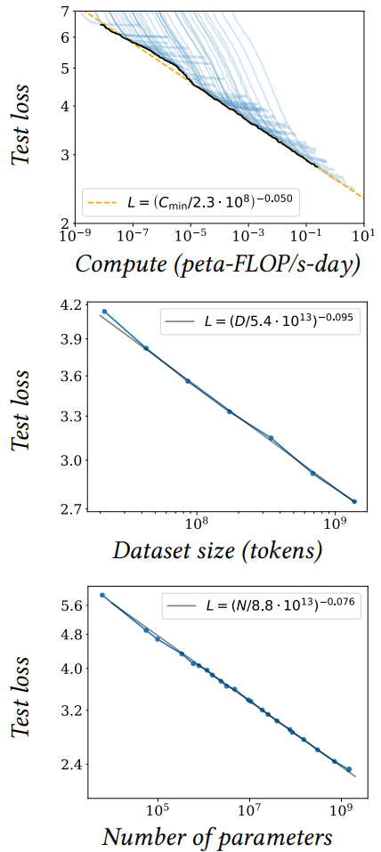
Size Matters: LARGE Language Models
scaling laws, Chinchilla: coupled performance power laws with model size, amount of training data, and compute
→ era of large-scale models
emergent abilities of LLMs:
multi-task learning: perform new tasks at test time without task-specific training (via prompting)
reasoning capabilities
source

Slide 29





Slide 30
Some LLM Numbers
as usual, comes in base and instruct variants
example Kimi K2 (Mixture-of-Experts model):
vocabulary size (tokens): 160K
embedding dimension: 7,168
context length (tokens): 128K
total parameters: 1T
training tokens: 15.5T
number of layers: 61
number of attention heads: 64
number of experts: 384
→ a lot of memorizing
compression of the internet

Slide 31
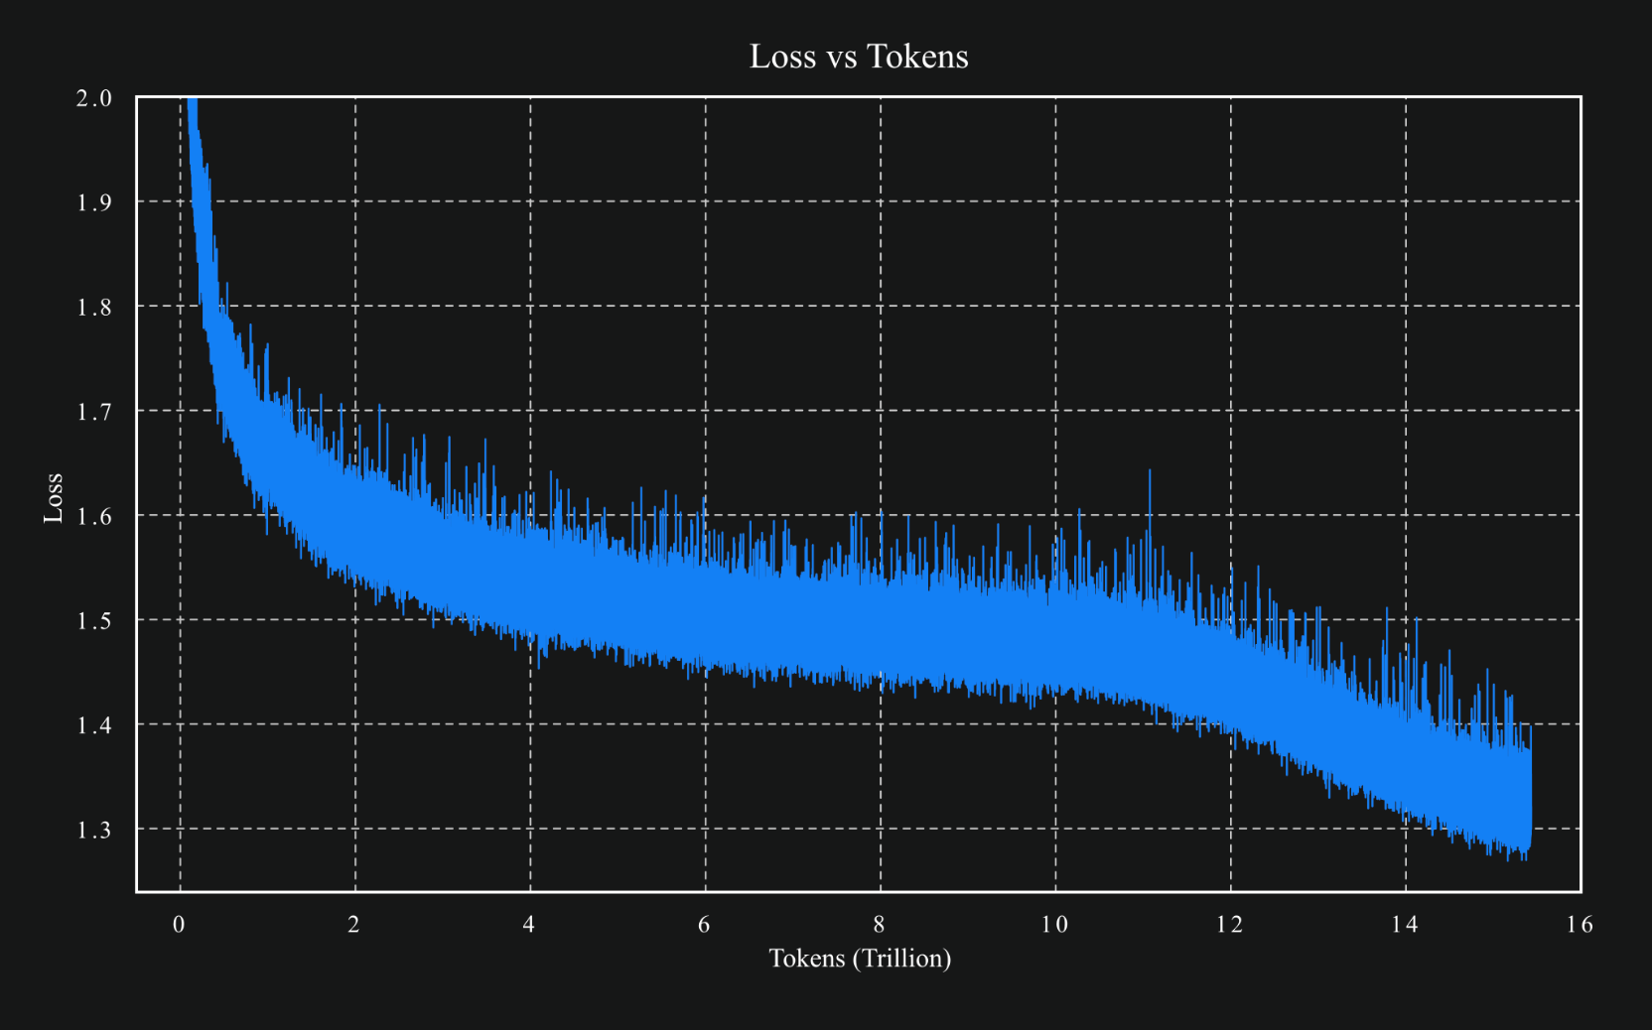
source

Slide 32
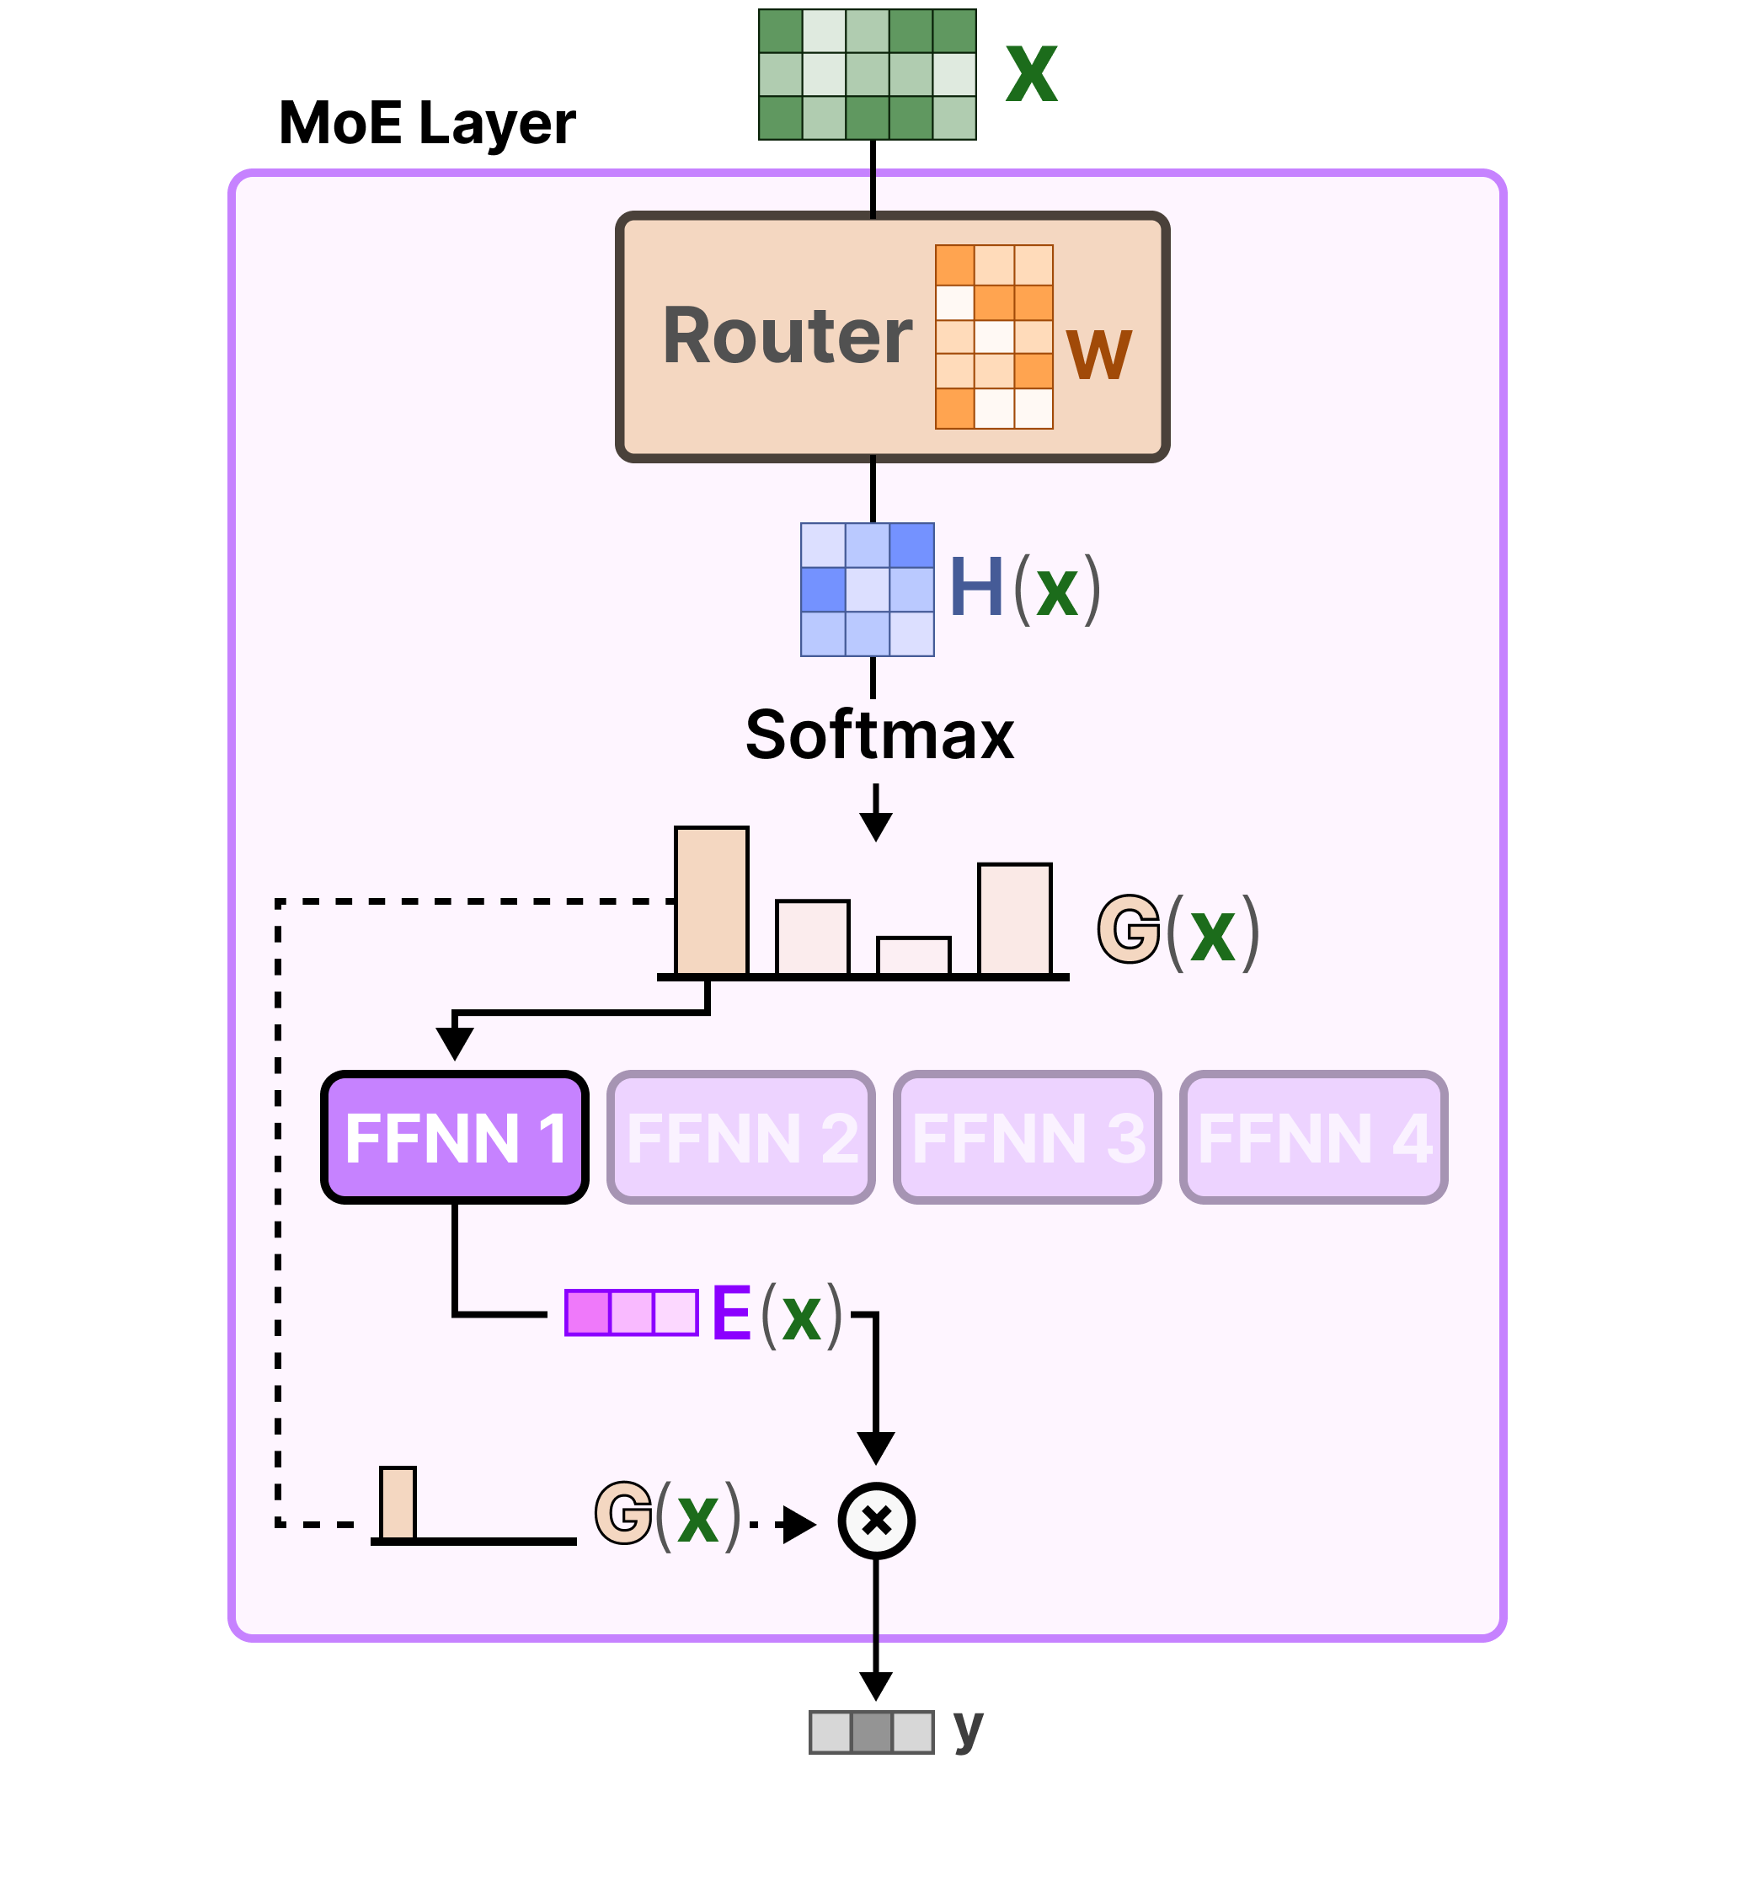
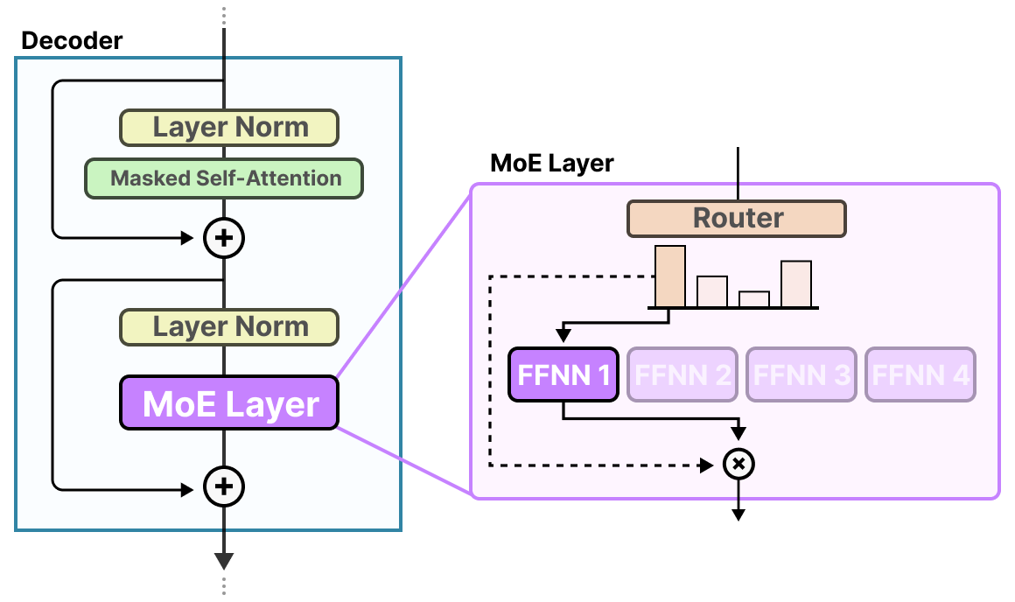
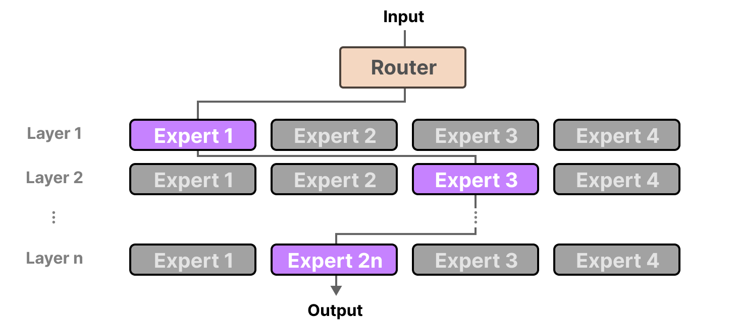
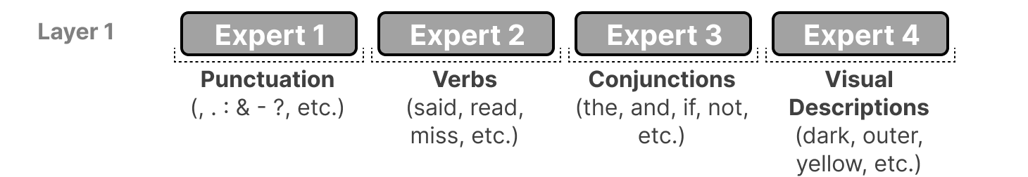
Mixture-of-Experts (MoE)
FFNN itself
idea: replace big FFNN with several smaller ones and activate only few
→ less active parameters
different paths for each token:
example (actually more abstract):

Slide 33
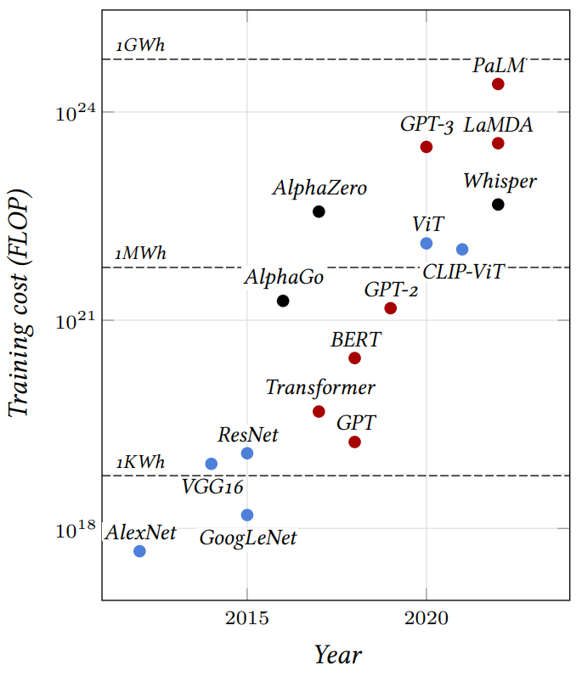
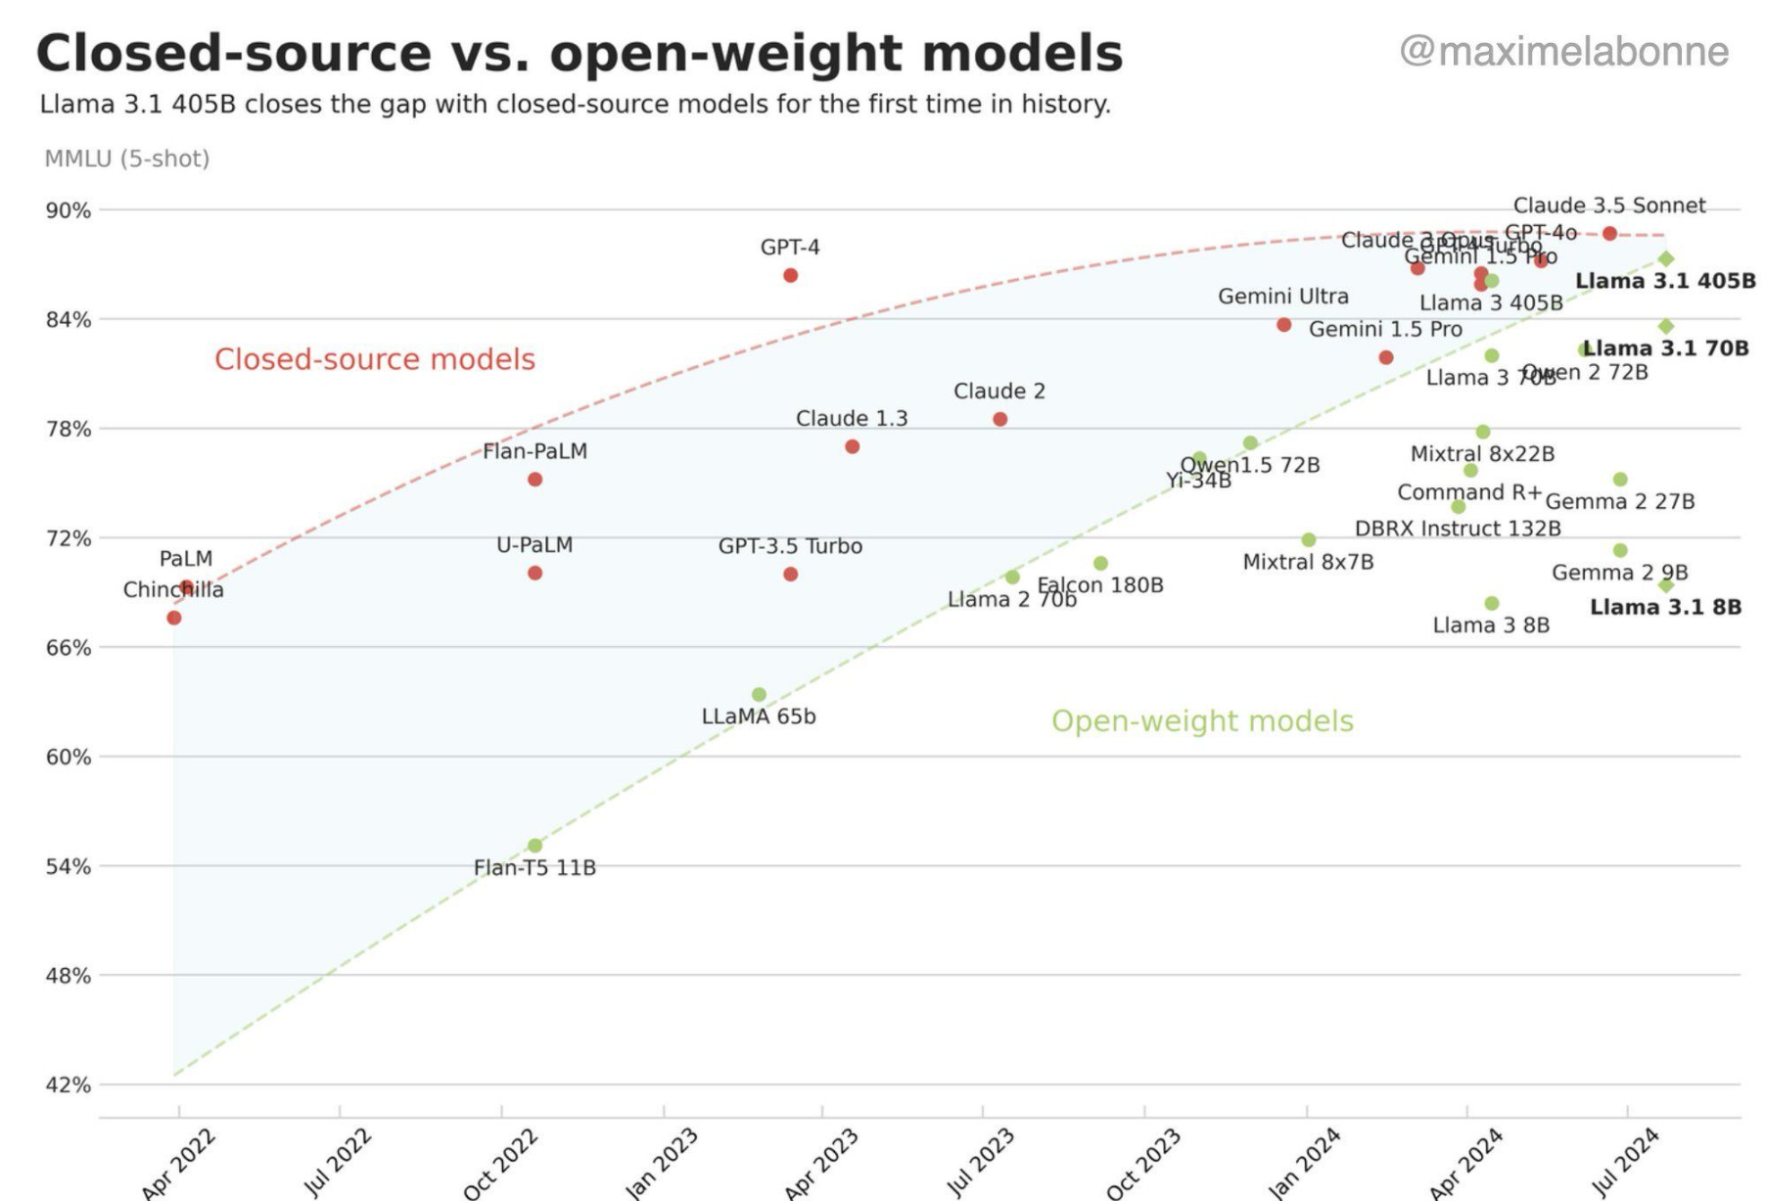
Llama 3
source

Slide 34
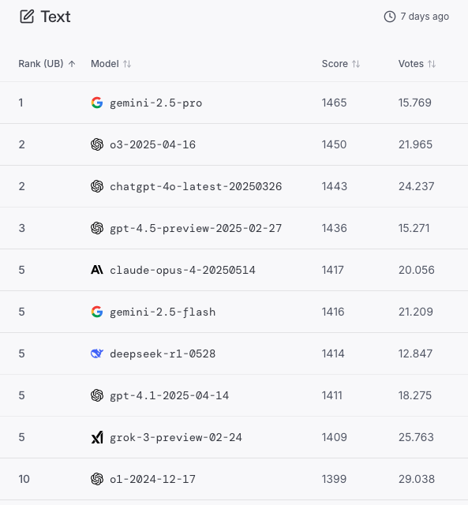
LMArena

Slide 35
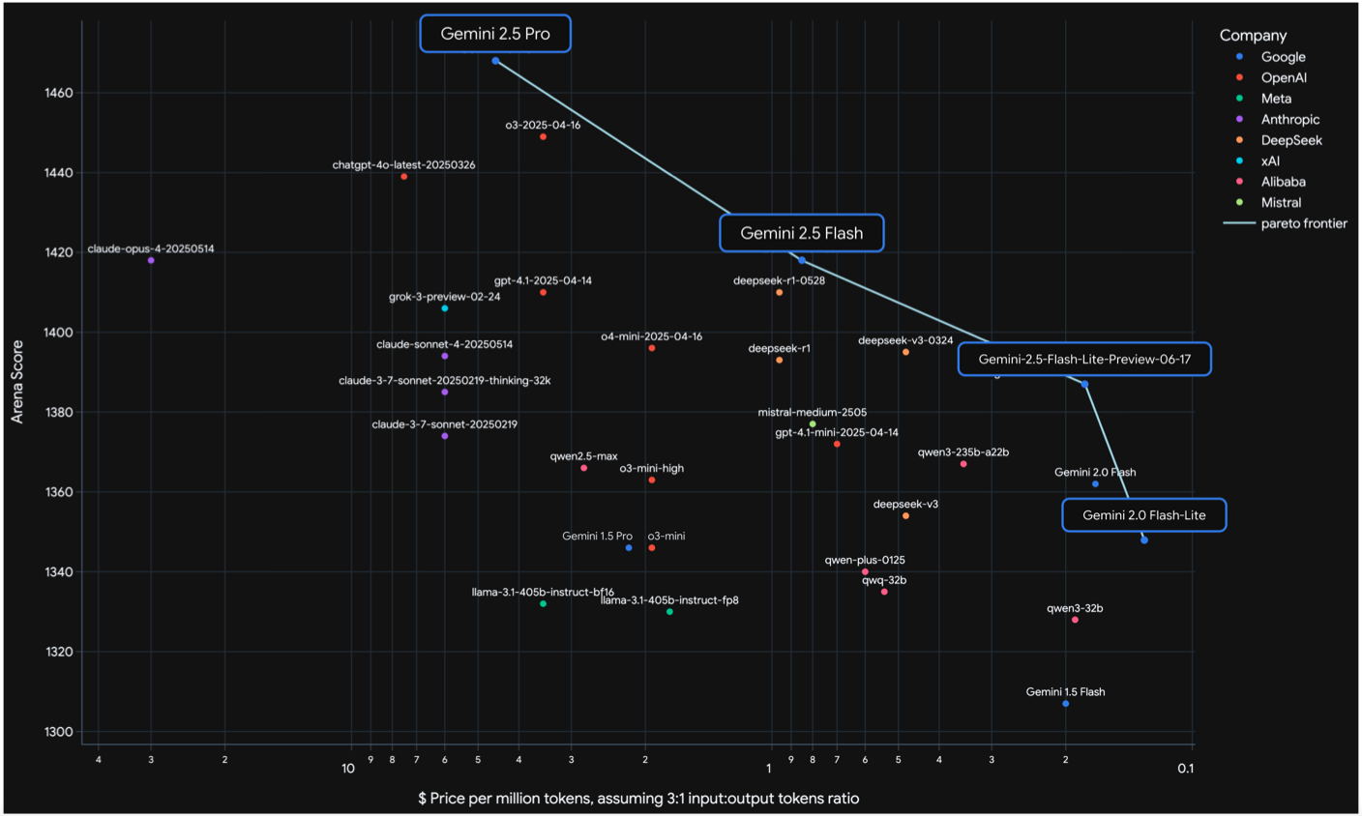
source

Slide 36
Another Trend: Small Language Models (SLM)
most powerful LLMs keep getting bigger (> 1 trillion parameters)
GPT-4o, Claude 3.5, Gemini 1.5, …
but slimmed-down (yet still strong) versions get smaller
Gemma (2B), Phi-3 (3.8B), Mistral 7B, Llama3 (8B), …
can run (inference) on laptops, smartphones, etc.
easier fine-tuning → specific tasks

